Slide 1
Safer Internet Day 2025
PREPARE/PROTECT/THRIVE
Primary Presentation:
5th & 6th Class
Notes:
Notes for speaker – brief introduction and welcome.
Explain how long the talk will take and the types of things you will be doing over that time.
For example:
‘Today we are joining millions of people around the world in celebrating Safer Internet Day, a day for promoting a safer and better internet for all users, especially children. During this assembly we are going to talk about the role technology and the internet plays in our world and daily life. We will look at the role of influencers and algorithms on our lives.’

Slide 2
What is Safer Internet Day?
webwise.ie/saferinternetday
A day to create awareness of a better internet for ALL users​
​
Safer Internet Day will be celebrated on Tuesday, February 11th 2025
​
Over 200,000 young people celebrated Safer Internet Day in Ireland in 2024
Notes:
Notes: Safer Internet Day (SID) is an EU wide initiative to promote a safer internet for all users, especially young people. Safer Internet Day in Ireland is promoted and coordinated by Webwise, the Irish Internet Safety Education Awareness Programme. The Theme for Safer Internet Day is “Together for a Better Internet”.
The aim of the day is a call on young people, parents, teachers, schools, government, businesses to join together to make the internet a safer and better place for all, and especially for children and young people.
Safer Internet Day is a day to promote safe and responsible use of the internet, a day for us to consider all the different ways we use the internet and how we can make the internet a safer and better place for all, and especially for children and young people.

Slide 3
Safer Internet Day 2025
Prepare / Protect / Thrive
Navigating algorithms and influencers
On Safer Internet Day, let’s take time to:
Reflect on the role and influence of social media influencers.
Understand how algorithms shape our online experience.
Develop strategies to manage your experience online and navigate the opportunities and challenges of these powerful influences.
Notes:
Notes: Run through the learning outcomes for this talk:​
On Safer Internet Day let's take time to:​
​
Reflect on the role and influence of social media influencers.
Understand how algorithms shape our online experience.
Develop strategies to manage your experience online and navigate the opportunities and challenges of these powerful influences.

Slide 4
Influencer
Let’s Brainstorm:
What comes to mind when you hear the word “influencer”?
Notes:
Notes: Today we are going to talk about how to be safe online, we are going to reflect on the role of influencers and social media algorthms in our lives.​
Ask pupils to brainstorm what comes to mind when they hear the word “influencer”.
Collate pupils feedback on the board.

Slide 5
Who do you follow?
Let’s Discuss:
Who are some influencers you follow or know about?
Why do you like them?
What do they usually talk about or promote?
Why do you think they’re called “influencers”?
Notes:
Notes: Ask pupils to think about social media influencers they know about or follow and discuss as a group:
Who are some influencers you follow or know about?
Why do you like them?
What do they usually talk about or promote?
Why do you think they’re called “influencers”?

Slide 6
What is an Influencer?
Let’s Define:
An influencer is someone who has a large following on social media and can shape trends, opinions, or behaviours. They could be interested in gaming, makeup, news, sports, fitness, fashion, etc.
Notes:
Notes: Read the definition of an influencer with pupils: An influencer is someone who has a large following on social media and can shape trends, opinions, or behaviours. They could be interested in gaming, makeup, news, sports, fitness – ANYTHING.

Slide 7
Under the Influence?
Agree/Disagree
Let’s Reflect:
I trust influencers' opinions on a product more than advertisements from companies.
I follow influencers because they are relatable to me.
Seeing influencers with perfect lives makes me feel pressured to be like them.
Notes:
Notes: Use the following statements to reflect on the different ways that online content can influence people’s ideas, emotions and behaviour both positively and negatively.
Agree/Unsure/Disagree Statements:
I trust influencers' opinions on a product more than advertisements from companies.
I follow influencers because they are relatable to me.
Seeing influencers with perfect lives makes me feel pressured to be like them.

Slide 8
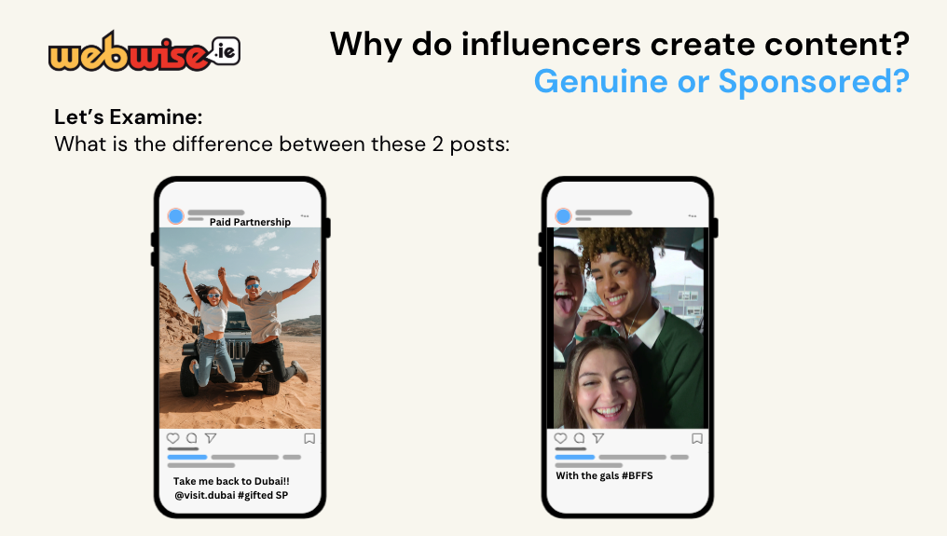
Why do influencers create content?Genuine or Sponsored?
Let’s Examine:
What is the difference between these 2 posts:
Paid Partnership
Take me back to Dubai!! @visit.dubai #gifted SP
With the gals #BFFS
Notes:
Notes: Show two examples of social media posts:
A genuine post about their life.
A paid partnership post promoting holidaying in Dubai with Visit Dubai. Look for the #gifted, SP (Sponsored Post) and Paid Promotion tags on the post.
Ask pupils if they can identify the differences between the posts.

Slide 9
Influencer Advertising
Rules for Influencers when advertising from the Advertising Standards Authority:
Tell Followers: Influencers need to tell their followers when they are advertising so they can tell the difference between regular posts and ads.
Use Clear labels: Use labels like '#Ad' ‘#gifted’ or ‘Paid Partnership’ at the beginning of their post.
When to Label: They must label a post as an ad if:
They get paid money.
They receive free products, discounts, or trips.​
They promote their own products or a family member's or friend's brand.
Be Honest: Make sure followers can easily see that it's an ad. Don't hide the label at the end or in a place where it's hard to find.
Notes:
Notes: Next, go through the rules for influencers when advertising from the Advertising Standards Authority Ireland:
Tell Followers: Influencers need to tell their followers when they are advertising so they can tell the difference between regular posts and ads.
Use Clear labels: Use labels like '#Ad' ‘#gifted’ or ‘Paid partnership’ at the beginning of their post.
When to Label: They must label a post as an ad if:
They get paid money.
They receive free products, discounts, or trips.
They promote their own products or a family member's or friend's brand.
Be Honest: Make sure followers can easily see that it's an ad. Don't hide the label at the end or in a place where it's hard to find.

Slide 10
The Impact of Influencers
Let’s Brainstorm:
Positive Influences
Potential Risks
Notes:
Notes: Using Think-Pair-Share, ask pupils to brainstorm the positive influences and potential risks of influencers on social media.
Collate pupil’s feedback on the board.

Slide 11
The Impact of Influencers
Let’s Brainstorm:
Positive Influences
Inspiration and Motivation: Influencers can inspire you to try new hobbies and many share messages about self-confidence, kindness, or overcoming challenges.
Learning Opportunities: Share tips and knowledge about topics and introduce you to new cultures, ideas, or perspectives.
Entertainment: Provide fun, uplifting content.
Notes:
Notes: Go through the positive influences and potential risks with pupils.

Slide 12
The Impact of Influencers
Let’s Brainstorm:
Potential Risks
Unrealistic Standards: Influencers show only their best moments.
Hidden Advertising: Some influencers promote products they’re paid to advertise without making it clear. You might feel pressured to buy things you don’t need.
False Information:
Misinformation (accidental): When influencers accidentally share something false, like a fake health tip.
Disinformation (on purpose): When they knowingly share false information, like a hoax or conspiracy, to gain views or attention.
Over-Influence: Influencers may shape your opinions too strongly, making you agree with them without thinking critically.
Notes:
Notes: Go through the positive influences and potential risks with pupils.

Slide 13
Stop.Think.Check
Here are some tips to help you verify information online:
Check where the information is coming from – is it a trusted source?
Look for other trusted websites or news sources to see if they say the same thing.
Look beyond the headline... Headlines can be sensationalised or misleading to grab attention. Always read the full article to understand the context.
If you’re not sure about something...Don’t share it!
Is it a joke?
Just because information is going viral or being shared by someone you know doesn’t mean it's true.
Not sure about an image? You can also use tools like Google’s reverse image search or TinEye to find out where it originally came from.
Talk to someone about it, like a parent or a teacher, so they can help you figure out what’s true.
Notes:
Notes: Explain, it can be easy for mis and disinformation to spread online. The next time you see a shocking headline, a viral video, or a social media post that seems too good—or too bad—to be true... Stop Think and Check!
Then, go through the tips to help pupils verify information online:
Check where the information is coming from – is it a trusted source?
Look for other trusted websites or news sources to see if they say the same thing.
Look beyond the headline... Headlines can be sensationalised or misleading to grab attention. Always read the full article to understand the context.
If you’re not sure about something...Don’t share it!
Is it a joke?
Just because information is going viral or being shared by someone you know doesn’t mean it's true.
Not sure about an image? You can also use tools like Google’s reverse image search or TinEye to find out where it originally came from.
Talk to someone about it, like a parent or a teacher, so they can help you figure out what’s true.

Slide 14
Social Media Feeds and Algorithms
Let’s Watch:
This helpful explainer ‘Social media algorithms explained’ from CBC Kids News
How do algorithms influence what you see online?
IMPORTANT: Algorithms can play a big role in the type of content you see online including influencers.
Notes:
Notes: ​Explain to pupils that algorithms can play a big role in the type of content you see online including influencers.
Watch the video, ‘Social media algorithms explained’ from CBC Kids News available at https://www.youtube.com/watch?v=F5tz887wXCY
After watching the video, pupils clarify their understanding of algorithms and how they work.
Algorithms are complex mathematical formulas working in the background of the websites or apps we use which help determine what content is presented to us online e.g., in your newsfeed or search results.
How It Works
It Watches What You Do
Every time you like a post, watch a video, or comment on something, the algorithm notices and keeps track.
Example: If you watch lots of cat videos, the algorithm will notice this and show you more cat videos.
It Shows You Similar Things
The algorithm starts showing you content it thinks is related to what you already like.
Example: After liking a football post, you might see more posts about football or other sports.
It Learns and Changes
The algorithm keeps learning based on what you do. If you stop watching cat videos and start liking cooking videos, it’ll shift and show you more recipes instead.
Ask them to consider, how do algorithms influence what you see online?

Slide 15
Benefits & Challenges of Algorithms
Let’s Brainstorm:
What are the benefits of algorithms?
What are the challenges with algorithms?
Notes:
Notes: Ask pupils to brainstorm what are the benefits and challenges of algorithms?
Collate pupil’s responses on the board.

Slide 16
Benefits & Challenges of Algorithms
Let’s Brainstorm:
What are the benefits of algorithms?
What are the challenges with algorithms?
Find What You Like: Can help you find things you’re interested in faster.
Discover New Interests: Can suggest new hobbies, music or ideas you might enjoy.
See Reliable Sources: Boost posts from trusted accounts if you follow them.
Amplify False Information: Algorithms highlight content that gets lots of likes and views even if it is not true or accurate.
Create Filter Bubbles: Algorithms tend to show more of the same type of content which can mean you miss out on other views or perspectives.
Time Trap: Algortims are designed to keep us on platforms for longer by using tricks like auto-play and showing you more content you might like.
Personal Information: Algorithms are building a picture of you based on your activity online (your likes, searches, views, clicks and shares).
Notes:
Notes: Go through the benefits and challenges of algorithms with pupils:

Slide 17
Managing Our Experience Online
What can we do to make the most of the content we explore online?
Understand Influencers: Some influencers promote products because they’re paid. Look for #ad or #gifted to spot these posts.
Question Content and Think Before You Share:
Who posted this?
Why? (Is it an ad, a joke, or a real story?)
Is it true?
Watch out for dramatic headlines or strange links.
Follow Wisely: Choose accounts that make you feel positive and inspired. Unfollow ones that upset or pressure you.
Don’t Compare Yourself: Remember, most photos and videos are edited or only show the best moments.
Stay in Control: Keep personal info private, explore new interests, set time limits, and be kind online.
Notes:
Notes: Next, go through the top tips and takeaways from today’s lesson for how pupils can make the most of the content they explore online:
Understand Influencers: Some influencers promote products because they’re paid. Look for #ad or #gifted to spot these posts.
Question Content and Think Before You Share:
Who posted this?
Why? (Is it an ad, a joke, or a real story?)
Is it true?
Watch out for dramatic headlines or strange links.
Follow Wisely: Choose accounts that make you feel positive and inspired. Unfollow ones that upset or pressure you.
Don’t Compare Yourself: Remember, most photos and videos are edited or only show the best moments.
Stay in Control: Keep personal info private, explore new interests, set time limits, and be kind online.

Slide 18
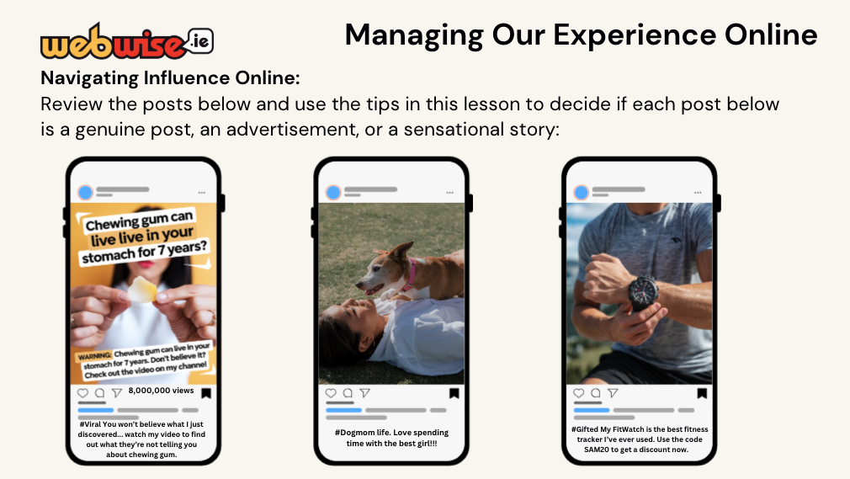
Managing Our Experience Online
Navigating Influence Online:
Review the posts below and use the tips in this lesson to decide if each post below is a genuine post, an advertisement, or a sensational story:
8,000,000 views
#Viral You won’t believe what I just discovered... watch my video to find out what they’re not telling you about chewing gum.
#Dogmom life. Love spending time with the best girl!!!
#Gifted My FitWatch is the best fitness tracker I’ve ever used. Use the code SAM20 to get a discount now.
Notes:
Notes: Navigating Influence Online Activity: Ask pupils to review the three posts on the slide and and use the tips in this lesson to decide if each post below is a genuine post, an advertisement, or a sensational story.
The first post is a sensational story that is false information.
The second post is a genuine post.
The third is a promoted post and advertisement on an influencers account.

Slide 19
Safer Internet Day 2025
Prepare / Protect / Thrive
Navigating algorithms and influencers
Take Home Activity
Read the scenario
Use the tips from today’s lesson to help you decide what to do next e.g. ask critical questions, check the facts, etc.
Notes:
Notes: Distribute the Safer Internet Day take home activity sheet available at www.webwise.ie/saferinternetday​
Pupils are to take this home and complete the activity with their parents/guardians and sign.

Slide 20
Safer Internet Day 2025
Prepare / Protect / Thrive
Navigating algorithms and influencers
Let’s Reflect:
What is one thing you learned today?
How will you use social media differently after this lesson?
Notes:
Notes: Ask pupils to reflect on what they have learned in today’s lesson using the following reflection prompts:
What is one thing you learned today?
How will you use social media differently after this lesson?

Slide 21
Safer Internet Day 2025
Prepare / Protect / Thrive
Navigating algorithms and influencers
On Safer Internet Day, you have learned:
The role and influence of social media influencers.
How algorithms shape our online experience.
Tips/strategies to manage your experience online and navigate the influences you may encounter online.
Notes:
Notes: Recap with pupils what they have discussed and learned during today's talk. On Safer Internet Day you have learned:​
The role and influence of social media influencers.
How algorithms shape our online experience.
Tips/strategies to manage your experience online and navigate the influences you may encounter online.

Slide 22
THANK YOU
internetsafety@oide.ie
© Webwise_Ireland​
This work is made available under the terms of the Creative Commons Attribution Share Alike 3.0 Licence http://creativecommons.org/licenses/by-sa/3.0/ie/. You may use and re-use this material (not including images and logos) free of charge in any format or medium, under the terms of the Creative Commons Attribution Share Alike Licence.​
Notes:
Notes: Highlight the Webwise.ie/Parents Hub and resources to parents/guardians by disseminating copies of the Parents Guide to a Better Internet. You can access the book digitally or order hard copies via webwise.ie

