Slide 2
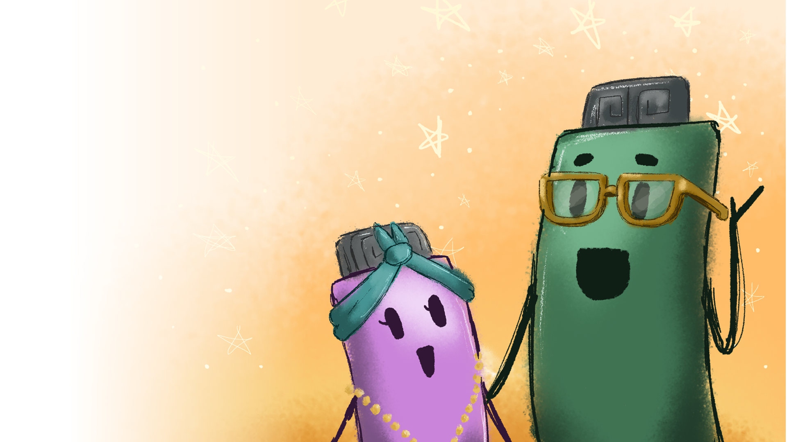
Ruby Becomes
an Upstander

Slide 3
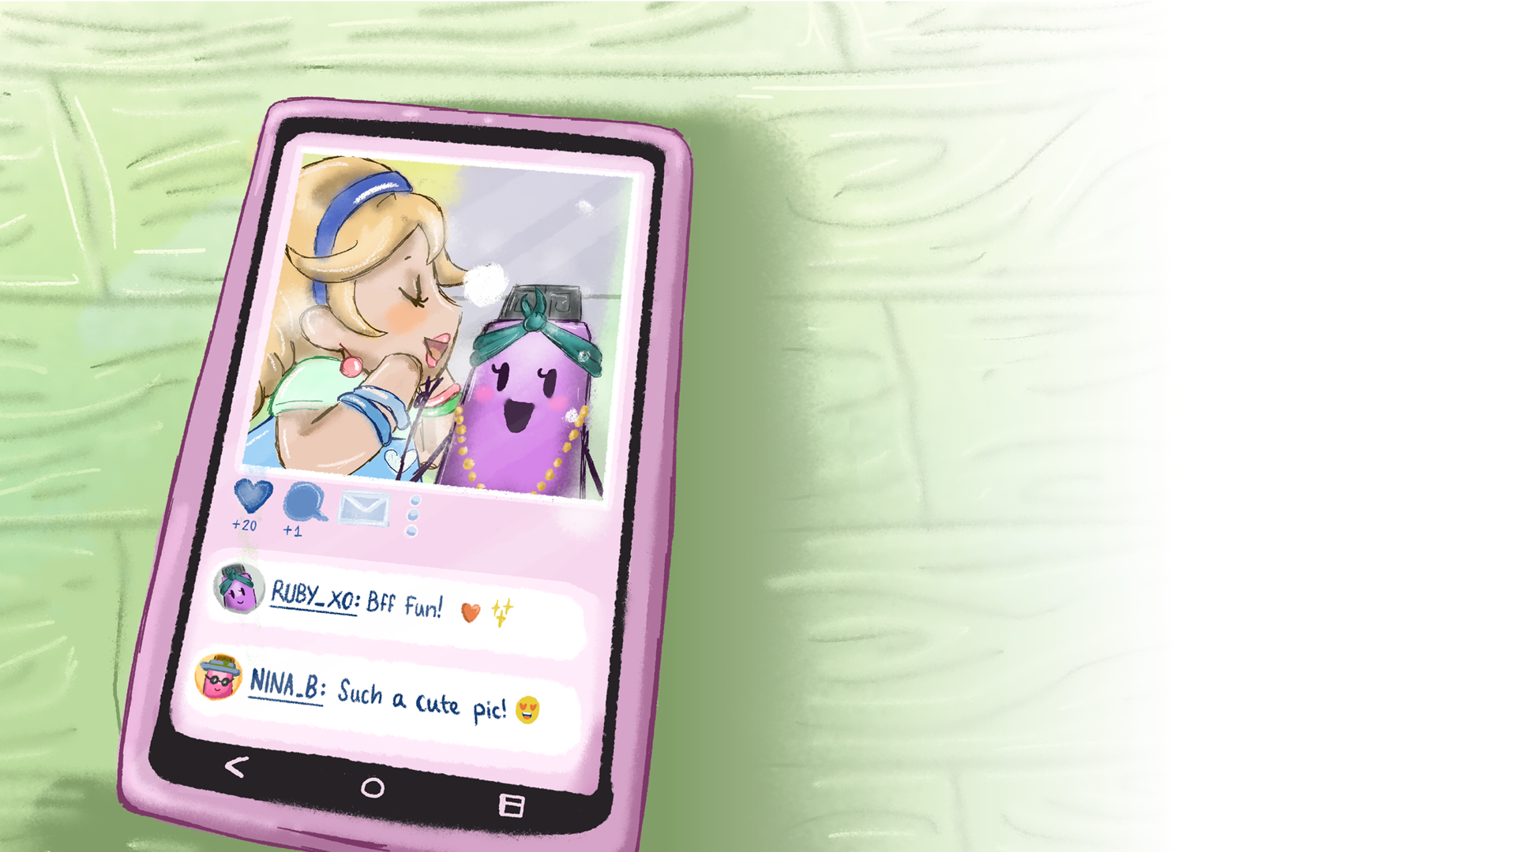
Ruby had become good friends with all the toys on the shelf above the teacher’s desk, but especially Dolly. Ruby had taken a photo with Dolly and wanted to share it with their friends.
​She shared the picture with friends on her favourite messaging site, Instachat. It was a really good photo which showed the two friends, laughing. Ruby was happy to see some of her friends ‘liking’ the photo and posting love-heart emojis and nice comments like, ‘Such a nice pic’ or ‘Best friends forever.’

Slide 4
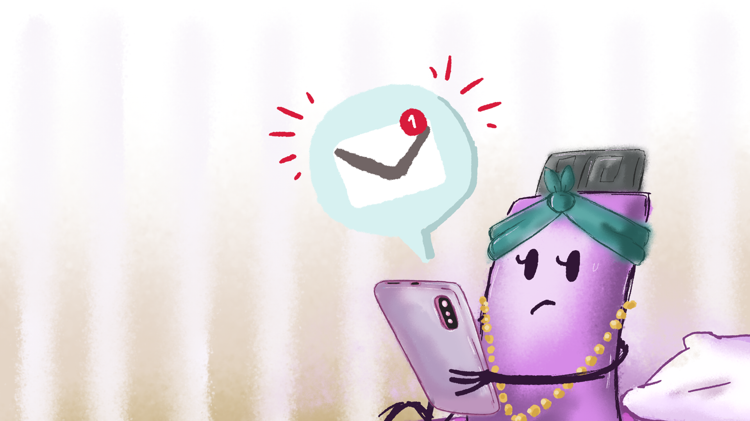
But then, a strange comment appeared from somebody she didn’t know. It said, ‘That doll has no eyes! Ha ha!’
​Ruby felt a cold shiver run down her circuit board. She looked at the photo again. In it, Ruby was looking straight at the camera, but Dolly was turned towards Ruby so that her single eye couldn’t be seen. From the photo, it looked like she had no eyes.
​Who would leave such a nasty comment?
​To make matters worse, other users were posting laughing emojis after the comment. How would Dolly feel if she saw this?

Slide 5
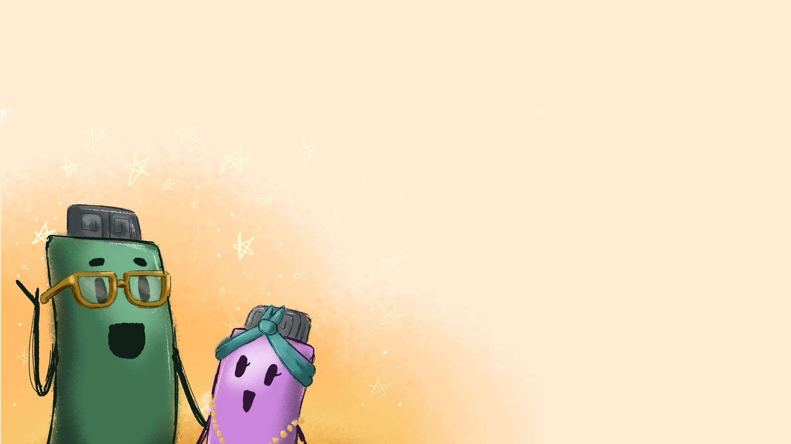
Ruby was worried, but didn’t know what to do, so she told her dad what had happened.
​‘That’s cyberbullying,’ he said.
​‘Cyberbullying?’ repeated Ruby. ‘What’s that?’
​‘It’s when someone hurts or bullies someone online.’
​‘What can we do about it, Dad?’
‘Well, you’ve got two choices, Ruby. You can be a bystander or an upstander.’
​Ruby frowned. ‘I don’t know what either of these words mean.’
​Ruby’s dad explained. ‘A bystander is someone who sees that something is wrong, but simply “stands by” and doesn’t do anything to help the person being bullied. An upstander is somebody, who not only sees that something is wrong, but stands up for the person being bullied, and takes action to make it right.’
​‘I definitely want to be an upstander,’ said Ruby, ‘but what can I do?’
​‘You’ve already taken a step in the right direction by telling me,’ said her dad, ‘but you could also ask the cyberbully to apologise.’

Slide 6
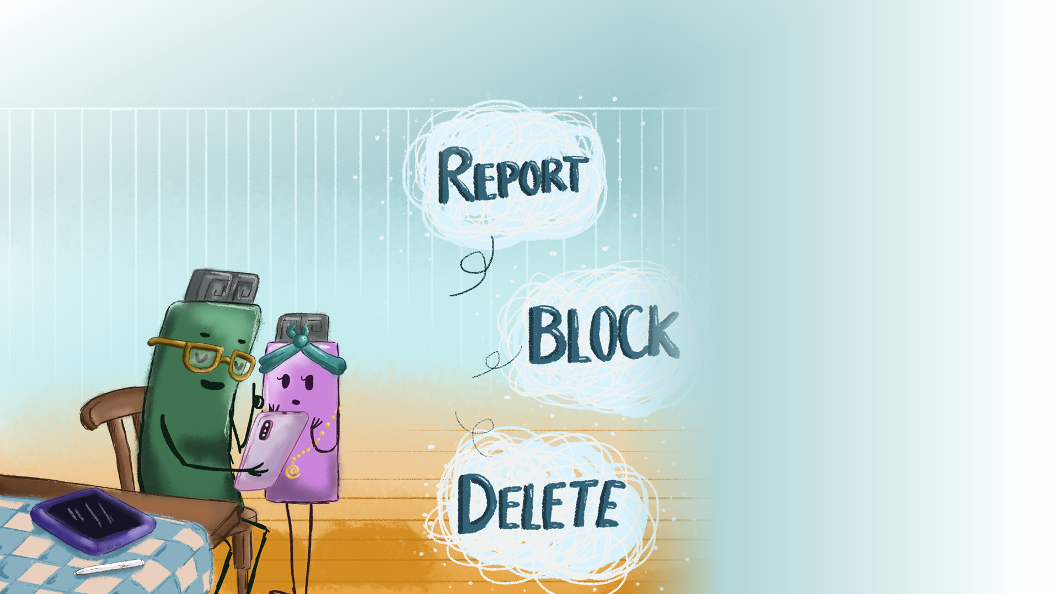
Ruby nodded, and her dad watched as she typed the following message to the person who sent the message. ‘This is a nasty comment and I think you should apologise.’
​She received a reply immediately – ‘Buzz off, loser!’
‘‘That person isn’t going to listen to me,’ said Ruby. ‘Is there something else we can do?’
We can report the bully to the company that owns the website and block them from seeing or commenting on your posts.’ Ruby’s dad showed her how to do it.
​‘I’d hate for Dolly to see all of this,’ said Ruby, nodding at the screen.
​‘You could delete the photo.’
​‘Good idea, Dad.’ When she hit the delete button, the photo disappeared, as well as all the nasty comments.

Slide 7
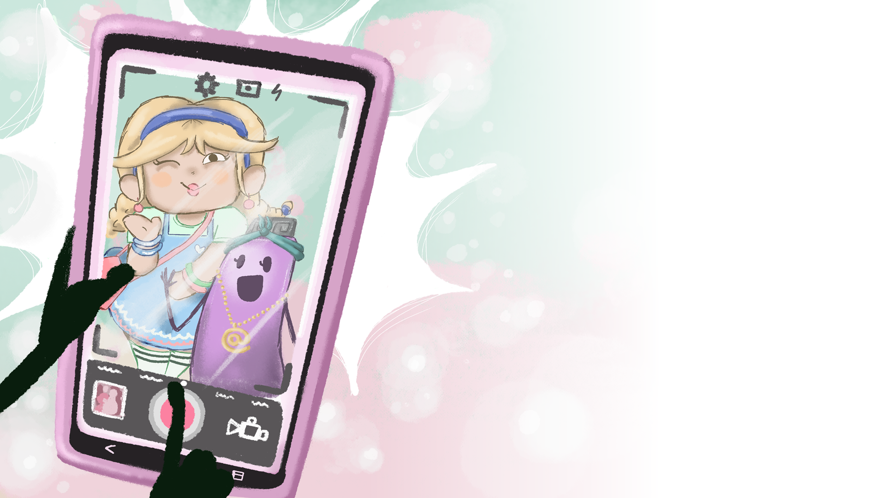
‘What are you guys doing?’ said a voice behind them.
Ruby and her dad turned around to see Dolly smiling at them.
‘I was just asking Dad if he’d take a photo of me and my best friend, Dolly,’ said Ruby.
‘Cool,’ said Dolly, putting her arm around Ruby while Ruby’s dad took a photo.
‘It looks fab,’ said Ruby, looking at the picture of herself and Dolly laughing. ‘Will we share it online, so that all our friends can see it?’
‘Great idea,’ said Dolly. ‘I know the toys will love it.’

