Slide 1


Lesson 2: Donal’s Story
Notes:
Slide 1: Today we are going to talk more about cyberbullying - how cyberbullying might happen and how someone who is being cyberbullied can be made to feel. We are also going to talk about how each one of us can act to protect ourselves and others from being cyberbullied and what we can all do to stop the cyberbullies.

Slide 2
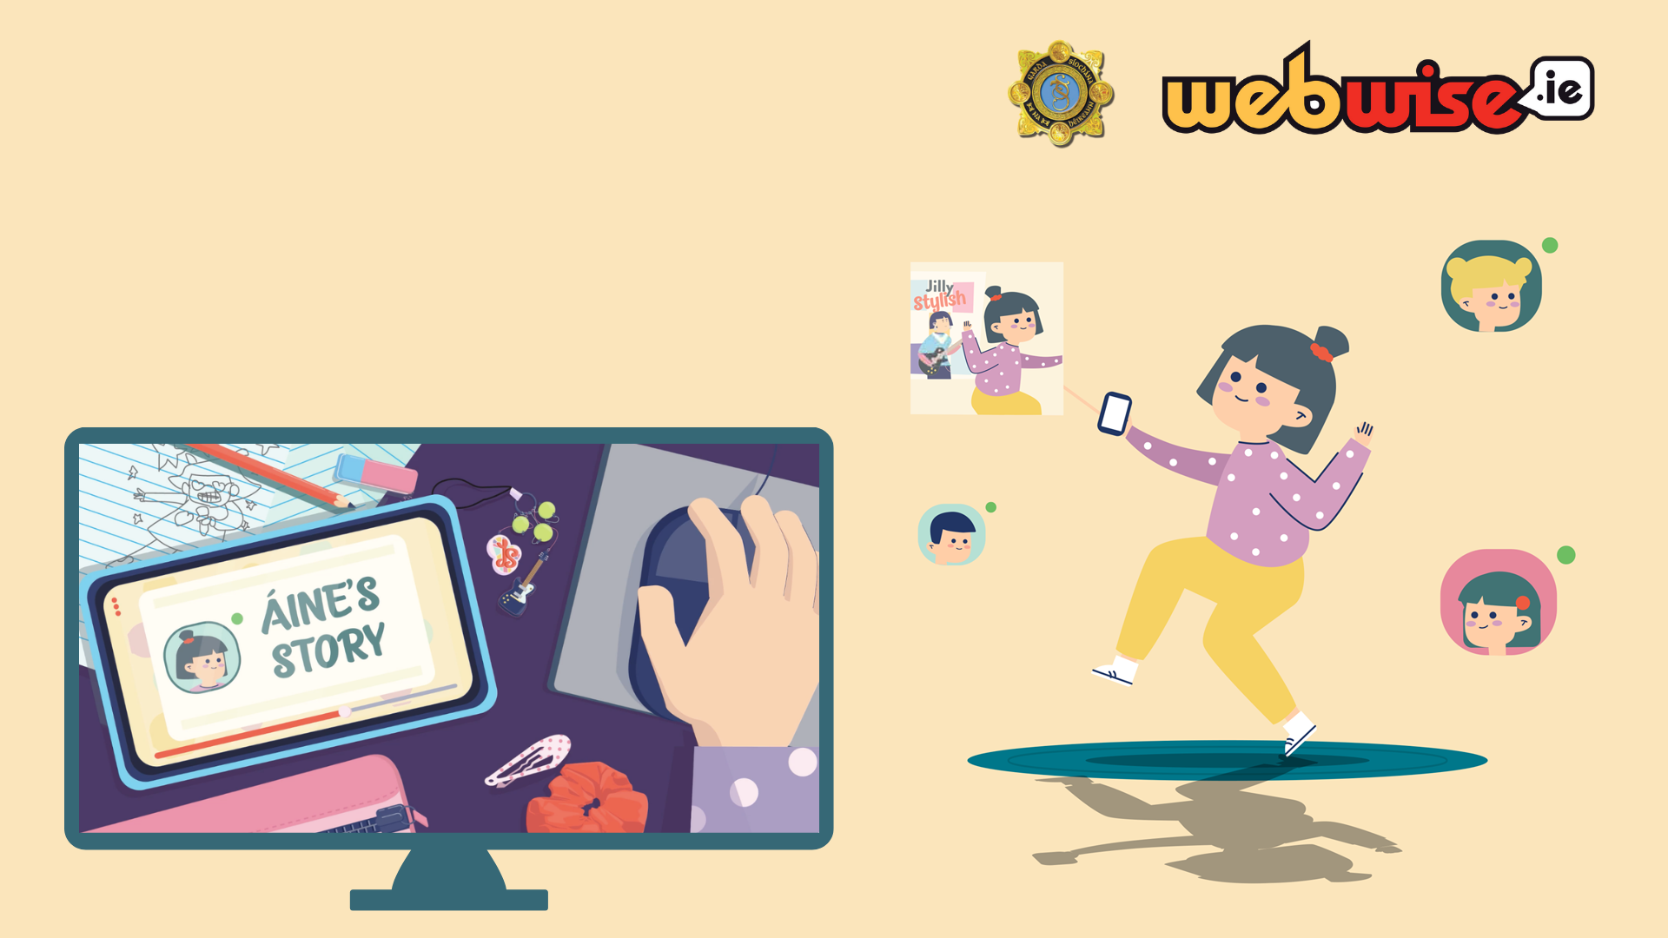
Lesson 1: Recap
Notes:
Slide 2: Introduction:
Recap on the previous lesson and what the pupils learned about cyberbullying – what it is and how it can happen and how it can make someone feel. Ask pupils to briefly recount what happened in Aine’s Story.

Slide 3

Click the screen below to play Donal’s Story
Notes:
Slide 3: Development: - Note video includes Pause Prompts for discussion – see questions below. Pause video when prompted.
Play Donal’s Story video clip: https://vimeo.com/448855325
Pupils watch video and break for discussion at discussion points.
A: What is going on here?
What do Emma’s, Paul’s and Samir’s comments mean?
How do you think Donal feels about this?
What should Donal do?
B: What is going on here?
Is there a worry that bullying might be taking place?
If so, who is being bullied and who might be doing it?
How are they bullying him?
C: Who is engaging in bullying here?
What form does the bullying take?
What about the other children? Are they adding to the bullying? If so How?
Why other children are behaving as they are?
What should Donal have done?
What should bystanders have done?
Should Alexander have done anything?
Should Donal mention what happened to Alexander and tell him his feelings about it?
Should he mention it to his parents, or any other adults?

Slide 4

What can you do if someone is being cyberbullied?
A) What advice would you give the ‘target’ person?
B) If you are being cyberbullied…
Don’t reply to messages that upset or annoy you
Keep the Message: You don’t have to read it, but keep it
Block the Sender: You don’t need to put up with someone upsetting you
Tell an adult you trust who can help
A report should be made to the Gardaí in serious cases of bullying and cyberbullying
Notes:
Slide 4: What can you do if you or someone else you know is being cyberbullied?
Using the video as an example what advice would you give
The ‘target’ person - what could / should they do?
Here we need to remind the pupils about the importance of telling an adult about what is happening. Remind the pupils of the Tell 5 adults from the Stay Safe programme. Who could they tell? Parent, Teacher, Trusted adult
B) If you are being cyberbullied…
Don’t reply to messages that upset or annoy you
Keep the Message: You don’t have to read it, but keep it
Block the Sender: You don’t need to put up with someone upsetting you
Tell an adult you trust who can help
A report should be made to the Gardai in serious cases of bullying and cyberbullying

Slide 5
What could the other gamers do?
How could they have supported the ‘target’ person?
Let them and the person making the comments or sending the messages know that they don’t agree with or like the nasty comments or messages.
How could they have stopped the cyberbullying?
Not sharing or adding to the comments or messages. Reporting what is happening to a trusted adult.
If possible reporting what is happening in the game (app) or platform.
Remember: Other people can play an important role in getting help for the person being cyberbullied and reporting it to a trusted adult.
Notes:
Slide 5: The other gamers - what could / should they do?
In the video we saw how some of the other gamers contributed to the cyberbullying. Ask the pupils to suggest how the other gamers could have behaved differently. What could they have done?
How could they have supported the ‘target’ person? Let them and the person making the comments or sending the messages know that they don’t agree with or like the nasty comments or messages.
How could they have stopped the cyberbullying? Not sharing or adding to the comments or messages. Reporting what is happening to a trusted adult. If possible reporting what is happening in the game or app. (the platform)
Emphasise here the important role other people can play in getting help for the person being cyberbullied and reporting it to a trusted adult.

Slide 6

What should you do if someone else is being cyberbullied?
Let that person know you support them
Don’t join in or share any comments, posts or pictures that may hurt others
Report the cyberbullying to someone who can help
– a parent/guardian or teacher
If you see nasty comments online report them to the platform
No one should ever experience cyberbullying. We can all help make the internet a better place by standing up to cyberbullying.
Notes:
Slide 6: What should you do if someone else is being cyberbullied?
Let that person know you support them
Don’t join in or share any comments, posts or pictures
that may hurt others
Report the cyberbullying to someone who can help
– a parent or teacher.
If you see nasty comments online report them to the platform
No one should ever experience cyberbullying. We can all help make the internet a better place by standing up to cyberbullying.

Slide 7
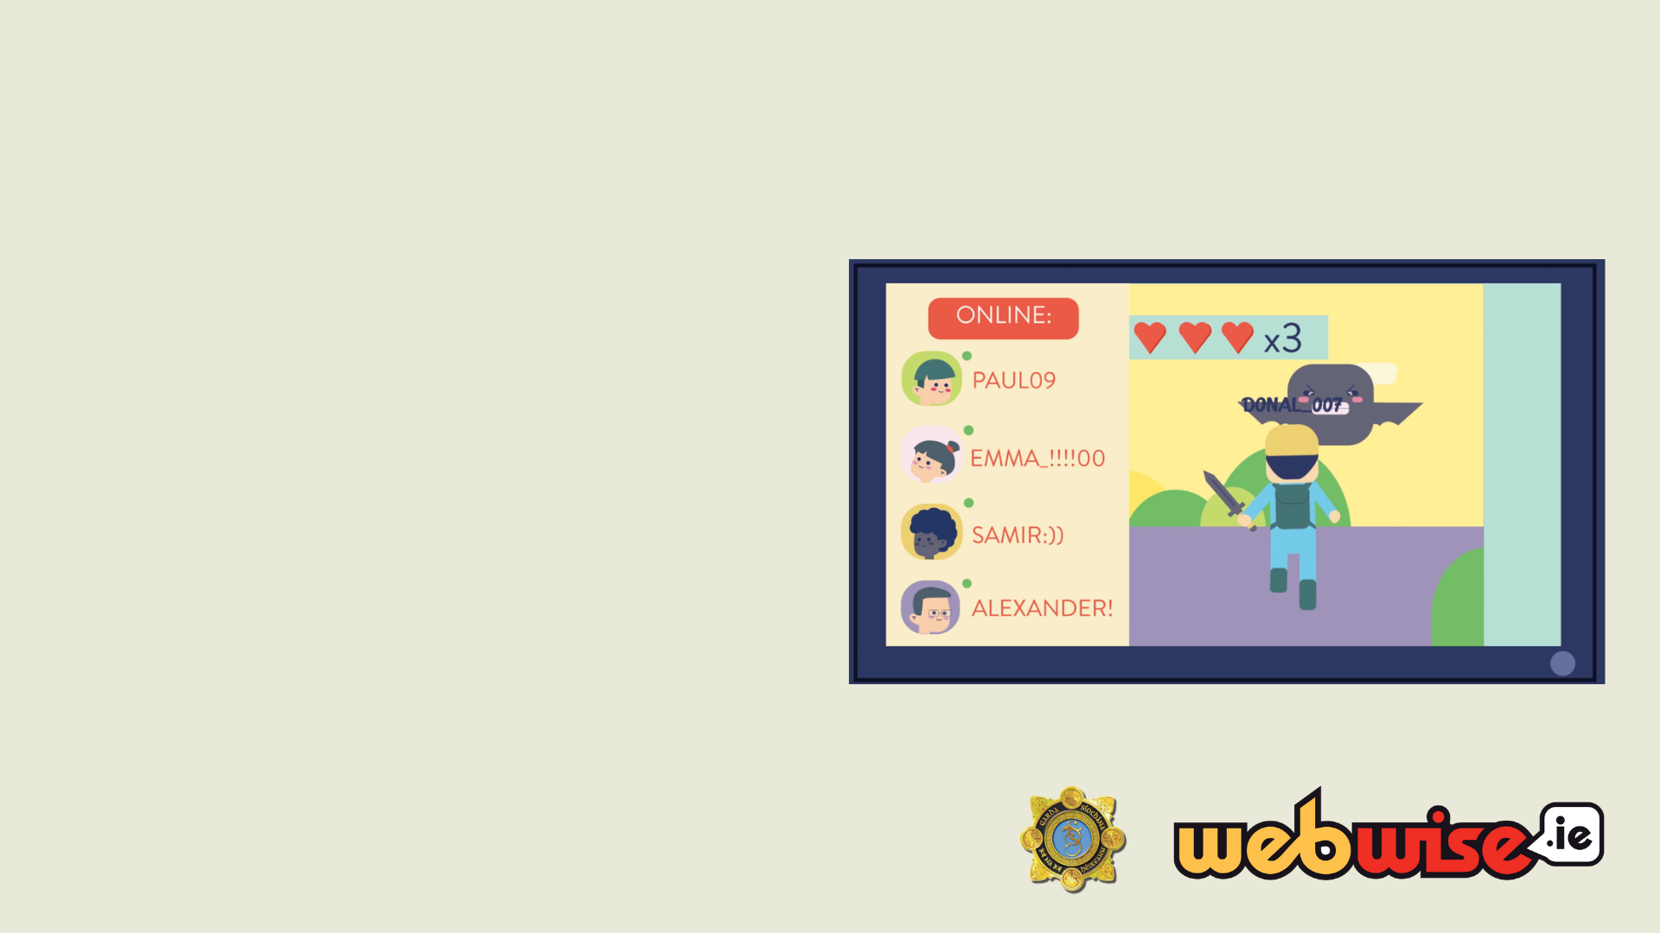
What could/should those involved do?
How are Paul, Samir and Emma engaging in bullying behaviours during the game?
How could the players have reacted differently to Donal getting eaten and losing the team points in the first game?
How could those involved in bullying resolve the issue?
Remember those involved can always turn their behaviour around and resolve the issue.
Notes:
Slide 7: The Instigators - what could / should they do?
In the video we saw Paul, Samir and Emma post mean comments, target and exclude Donal from playing the game.
Ask the pupils to suggest how they can turn their behaviour around and resolve the issue.
• How are Paul, Samir and Emma engaging in bullying behaviours during the game? They ignore Donal in the group chat, target Donal in the game, refuse to let Donal play with them again and post an embarrassing picture of Donal, making nasty comments about him in the chatroom.
• How could the players have reacted differently to Donal getting eaten and losing the team points in the first game? When Donal apologised after the game Paul, Samir and Emma could have reassured Donal that it was okay he got eaten as so did they later on. They can reassure Donal that they will all try better the next time.
• How could those involved in bullying resolve the issue? They can apologise to Donal. They can Invite him to play with everyone in the game.
Emphasise that the instigator can always turn their behaviour around and resolve the issue.

Slide 8
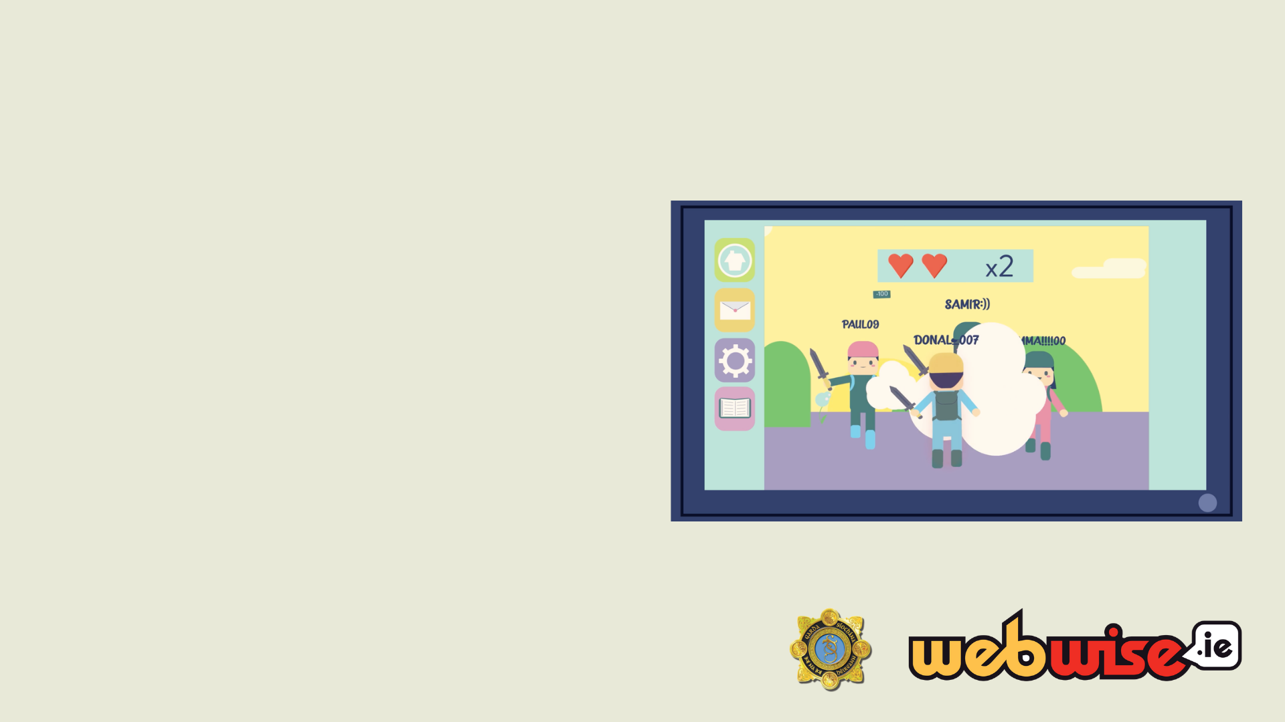
What should you do if you are involved?
Recognise that what you did was wrong
Say sorry to the person you hurt
Think before you post online - how will this make other people feel?
It’s okay not to feel okay. But picking on someone because you are feeling upset or angry is not the right way to deal with these emotions.
Get help from a parent/school counsellor/trusted adult
Notes:
Slide 8: What should you do if you are involved in or encourage bullying online?
Recognise that what you did was wrong and hurt someone else’s feelings.
Say sorry to the person you hurt.
Think before you post online - how will this make other people feel?
It’s okay not to feel okay. But picking on someone because you are feeling upset or angry is not the right way to deal with these emotions.
Get help from a parent / school counsellor/ trusted adult and talk about how you can better deal with how you’re feeling.

Slide 9

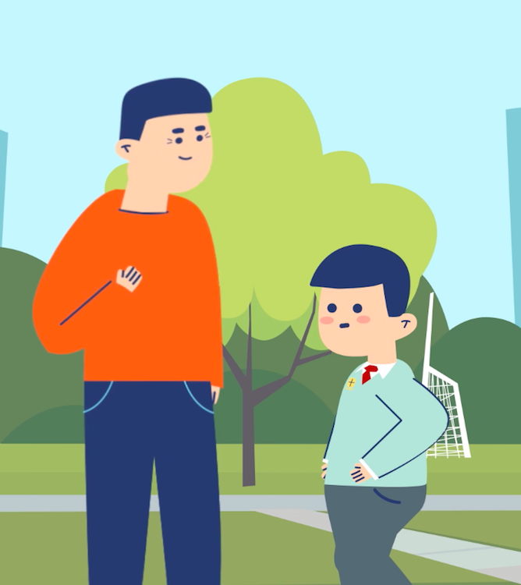
Why tell an adult?
Who can you tell?
Parent, guardian, teacher, principal, coach or another adult.
How can they help?
Support, sympathise, help to stop the bullying.
Remember: Keep telling until someone does something to help.
Notes:
Slide 9: Why Tell an adult?
It is important that an adult who can help is told if you or someone else is being cyber bullied. Discuss with the pupils what they would hope the adult might do e.g. support them, sympathise with what is happening, talk to the teacher, the principal, coach or some other adult that can help make it stop.
Remind the children that if it is important that if nothing is done that they talk to another adult that can help. Remind them of their Stay safe rules ..Keep telling until someone does something to help.

Slide 10

What the Gardaí will do if cyberbullying is reported to them?
Gardaí understand that reporting incidents can be difficult
Gardaí will work with everyone involved to resolve the issue
Notes:
Slide 10: What the Gardai will do if cyberbullying is reported to them.
Gardaí understand that coming to a Garda Station to report Cyberbullying is a very difficult thing to do. The Garda will try and make you feel as comfortable as possible. After the Garda takes your name address and your parents details they will ask you questions such as:
· When did the cyberbullying started?
· How long has it been going on for?
· Who is doing it?
· Why do you think they are doing it?
· Has this person/people ever bullied you face to face?
The Garda will ask to see the messages so make sure you have them all saved. The Garda will have to get a copy of all messages so if you bring a printed copy of the messages as well as the device where they are stored this would be a big help to the Garda. The next steps of the investigation will depend on the content of the messages. Typically a Garda will then contact the person/people who are sending the messages and the school if they are all in the same school.
Sometimes cyberbullying can be resolved through mediation between the parties, schools and Gardaí. In other, more serious cases people have been criminally prosecuted and have had juvenile cautions, fines and imprisonment

Slide 11
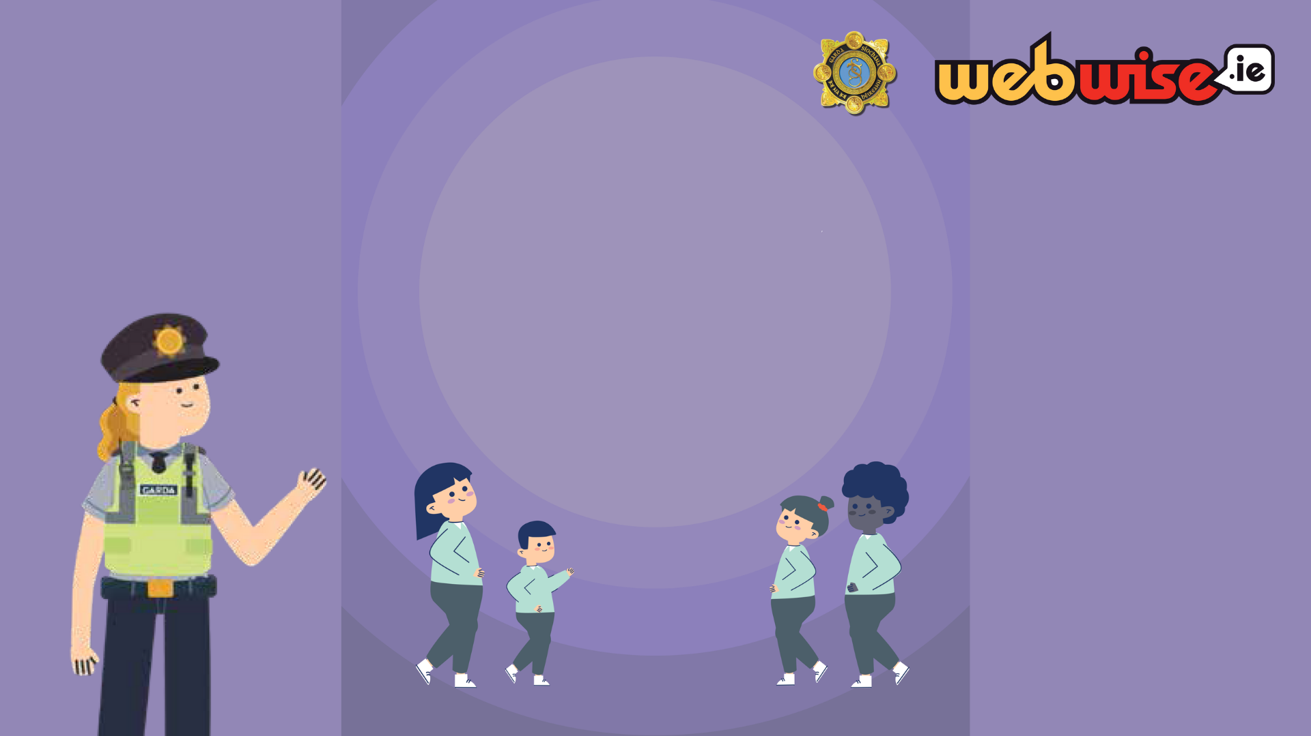
What we learned today?
Using technology and devices to play with, to communicate and to share pictures with others is good. However if we use technology to hurt or upset others that is cyberbullying. We can all help to stop cyber bullying. The most important thing we can do is to report it to an adult that can help.
Notes:
Slide 11: Conclusion
Using technology and devices to play with, to communicate and to share pictures with others is good. However if we use technology to hurt or upset others that is cyberbullying. We can all help to stop cyber bullying. The most important thing we can do is to report it to an adult that can help.
Distribute Worksheet 3: Take Home Activity

Slide 12

Activity: Make a poster
Cyberbullying: What can I do?
In groups write down one thing they could do to tackle cyberbullying
Notes:
Slide 12: Adidtional activity - If class time alllows –
Make a poster: Cyberbullying – What I could do
Working in groups (3 or 4 pupils) make a class poster using a template which could incorporate the school logo and the garda logo. Each group writes down one thing they could do to tackle cyberbullying. These can then be collated and made into a large class poster e.g. Don’t share nasty comments or pictures; Tell an adult that can help; be a friend to the person being hurt etc .
When the poster is finished it - with school logo and Garda logo a copy of the poster could be printed off and sent home with the home school link to be signed by pupil and parents??

Slide 13

Thank you.
Notes:
Slide 13: Present the class with the completed Online safety class agreement (Appendix 2)

