Slide 1






Webwise // Parents
Notes:
Welcome to the Webwise Parents Introduction to Online Safety talk. This talk is designed to introduce parents to the first steps of supporting children as the go online.

Slide 2

Hello!
I am INSERT NAME
Co-financed by the European Union - Connecting Europe Facility & Department of Education and Skills.
The overall objective of this workshop is to provide parents with information and skills to support their children's online activity.
Notes:
Notes for speaker – brief introduction and welcome.
Explain how long the talk will take and the types of things you will be doing over that time. For example
‘This evening we are going to talk to you about some common concerns parents have around internet safety. This one hour talk will look at topics such as screen time, cyber-bullying, online gaming and we’ll also do some group activities. The aim of the talk this evening is to give you an introduction to the topic, give you some tips for talking to your child, find out what supports are available and how to access them.’

Slide 3
Top concerns for Irish Parents: cyberbullying, spending too much time online, online grooming/exploitation and accessing in appropriate content.
Webwise // NPC Parenting Survey 2017
Notes:
A recent survey conducted by Webwise and the National Parents Council Primary found that Irish parents top concerns around internet safety include cyber-bullying, spending too much time online, online grooming exploitation and accessing inappropriate content.

Slide 4
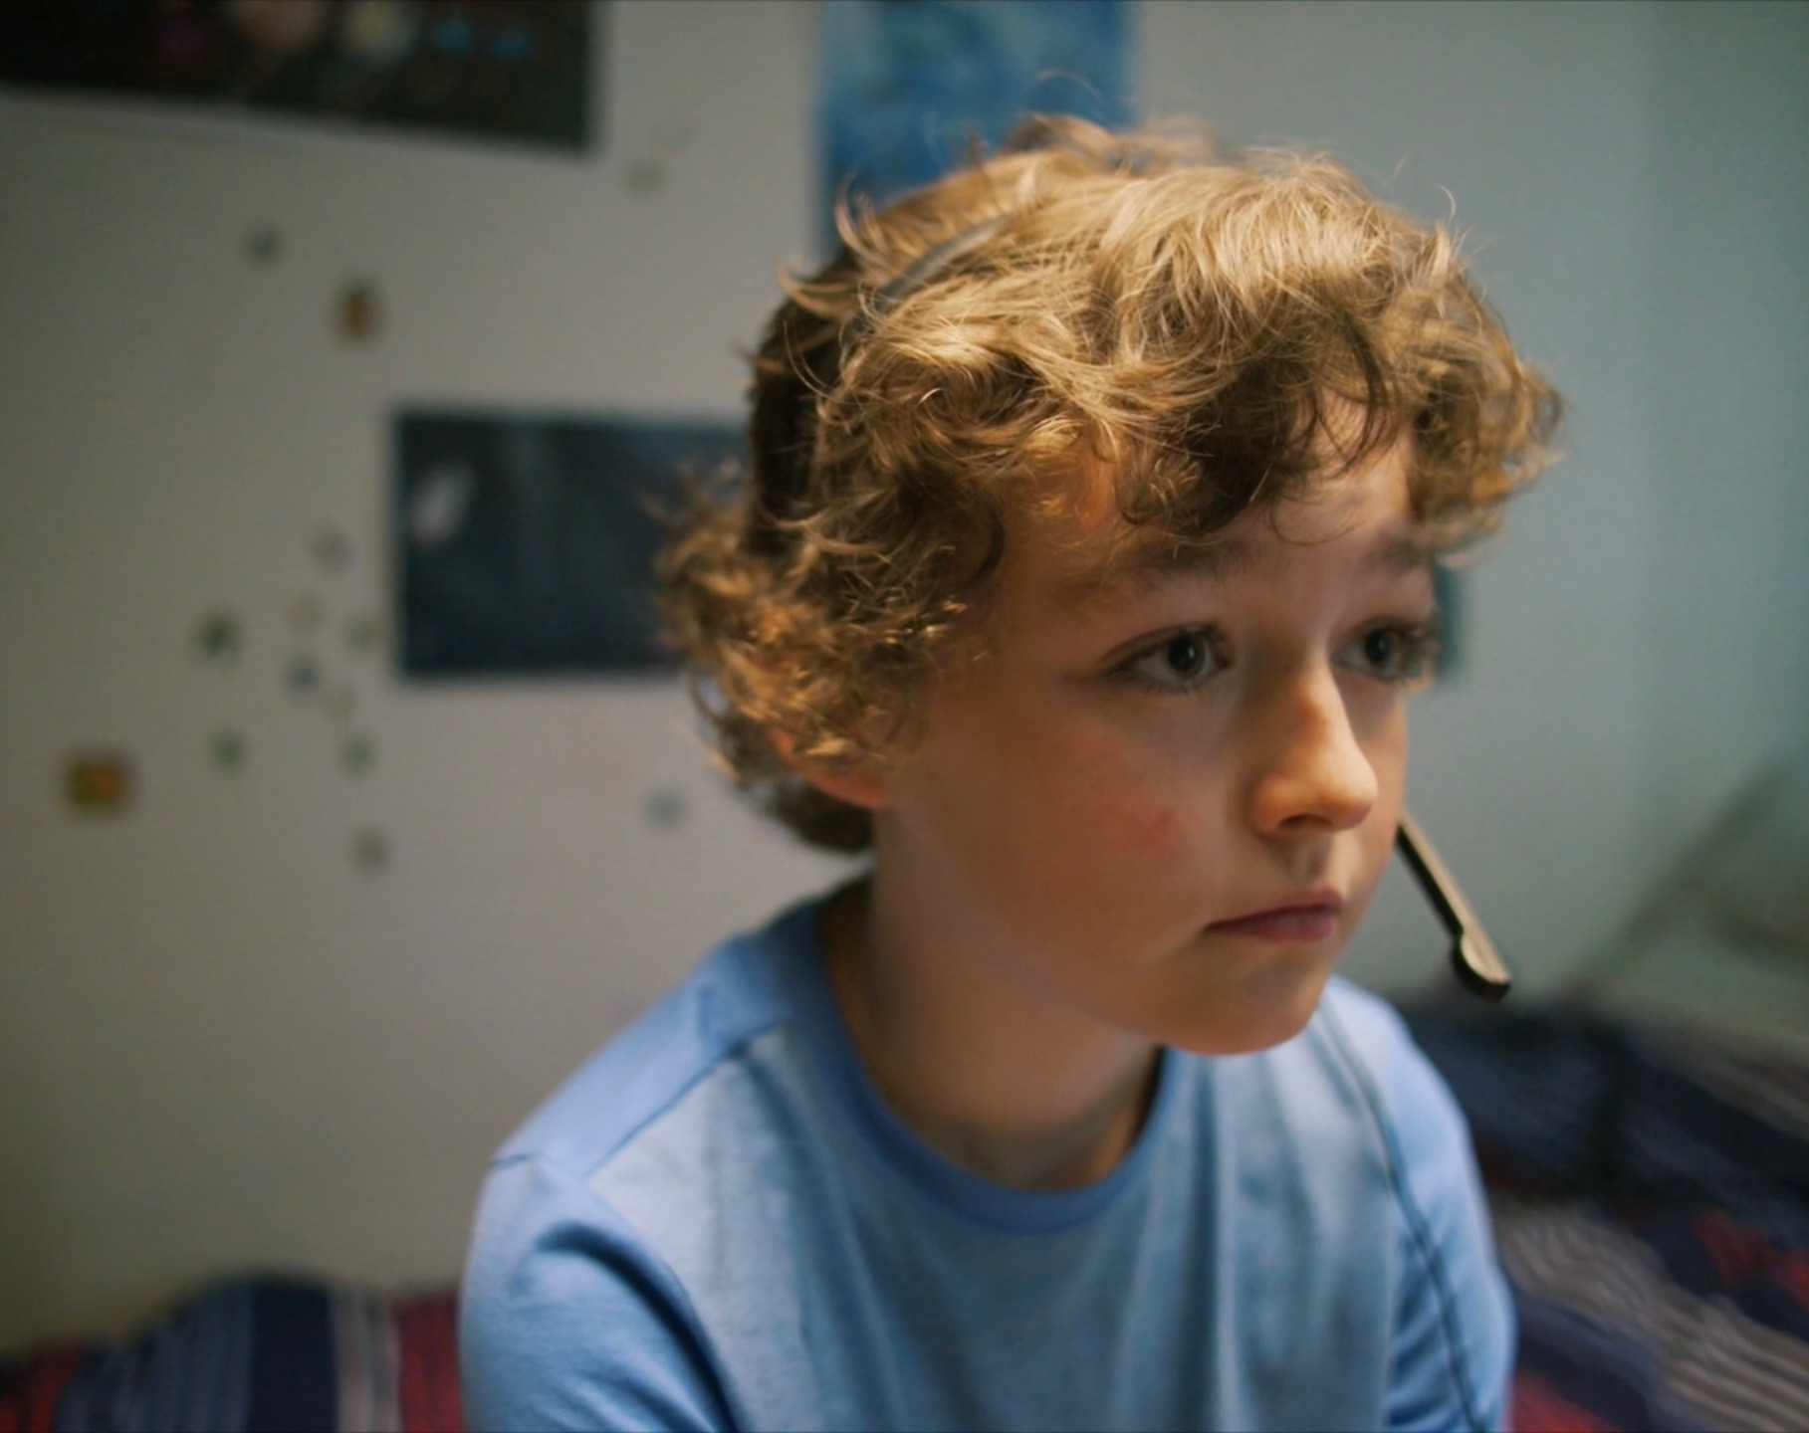
ACTIVITY: BENEFITS OF THE INTERNET FOR CHILDREN
REMEMBER THE BENEFITS OUTWEIGH THE RISKS!
Place your screenshot here
While undoubtedly there are valid concerns about children spending too much time online, accessing inappropriate content, and communicating with people with intent to harm or exploit them: it is equally clear that the internet presents fantastic opportunities for children.
What do you think are the main benefits for children from using the internet ?
Notes:
Group Discussion Activity
Ask the group ‘What do you think are the main benefits for children from using the internet ?’
Sample responses: Learning, communicating with people, developing new skills – coding, creativty, etc.

Slide 5



PRACTICAL STEPS FOR PARENTS
PARENTAL
SUPERVISION
USE PARENTAL CONTROLS
ACTIVATE SAFE SEARCH
AGREE ON WHAT TO DO IF THINGS GO WRONG!
Notes:
Internet Safety Advice for Parents of Young Children
It is never too early to think about your child’s safety online. If you are a parent of a young child who is just starting to discover the online world, there are a few things to consider:
Parental Supervision
It is very important that young children be supervised at all times while using the internet. It can be easy to access inappropriate content without intending to, parents should guide their child as they discover the online world for the first time.
Talk about Internet Safety with your Child
Have a conversation with your child on some of the important things to watch out for when going online for the first time. Young children will not be aware of the dangers, so it is very important to talk with them about who they talk to online and about sharing personal information online.
Use Parental Controls
Most internet technologies have built-in controls that allow you to limit the amount of time your child can spend online, restrict their access to adult content, and switch off functions like shopping and chatting. Filtering controls are particularly useful at preventing young children from accidentally encountering content that might bother them.
Disable In-App Purchases
Many apps and games give their users the option of buying additional game functionality, additional points/bonuses, or a host of other extras. Children can easily make purchases without even realising. You can disable in-app purchases using your phone/device settings.
Activate Safe Search
Help minimise the risk of your child coming across inappropriate content in response to search queries by activating “safe search” in your search engine.
Agree on what to do when things go wrong
We recommend that you speak to your child about what to do if they come across something on the internet that bothers them. This could be closing the laptop lid, or turning off the screen, and coming to get you.
Set Up a Family Email
Set up a family email address that your children can use when signing up to new games and websites online.
Play it Safe
For young children we would recommend that parents choose safe and appropriate games for their child to play online. Most games should have a PEGI rating to check what if they are age appropriate, parents should also check if a game allows for player interaction and if there is a safe chat mode.

Slide 6




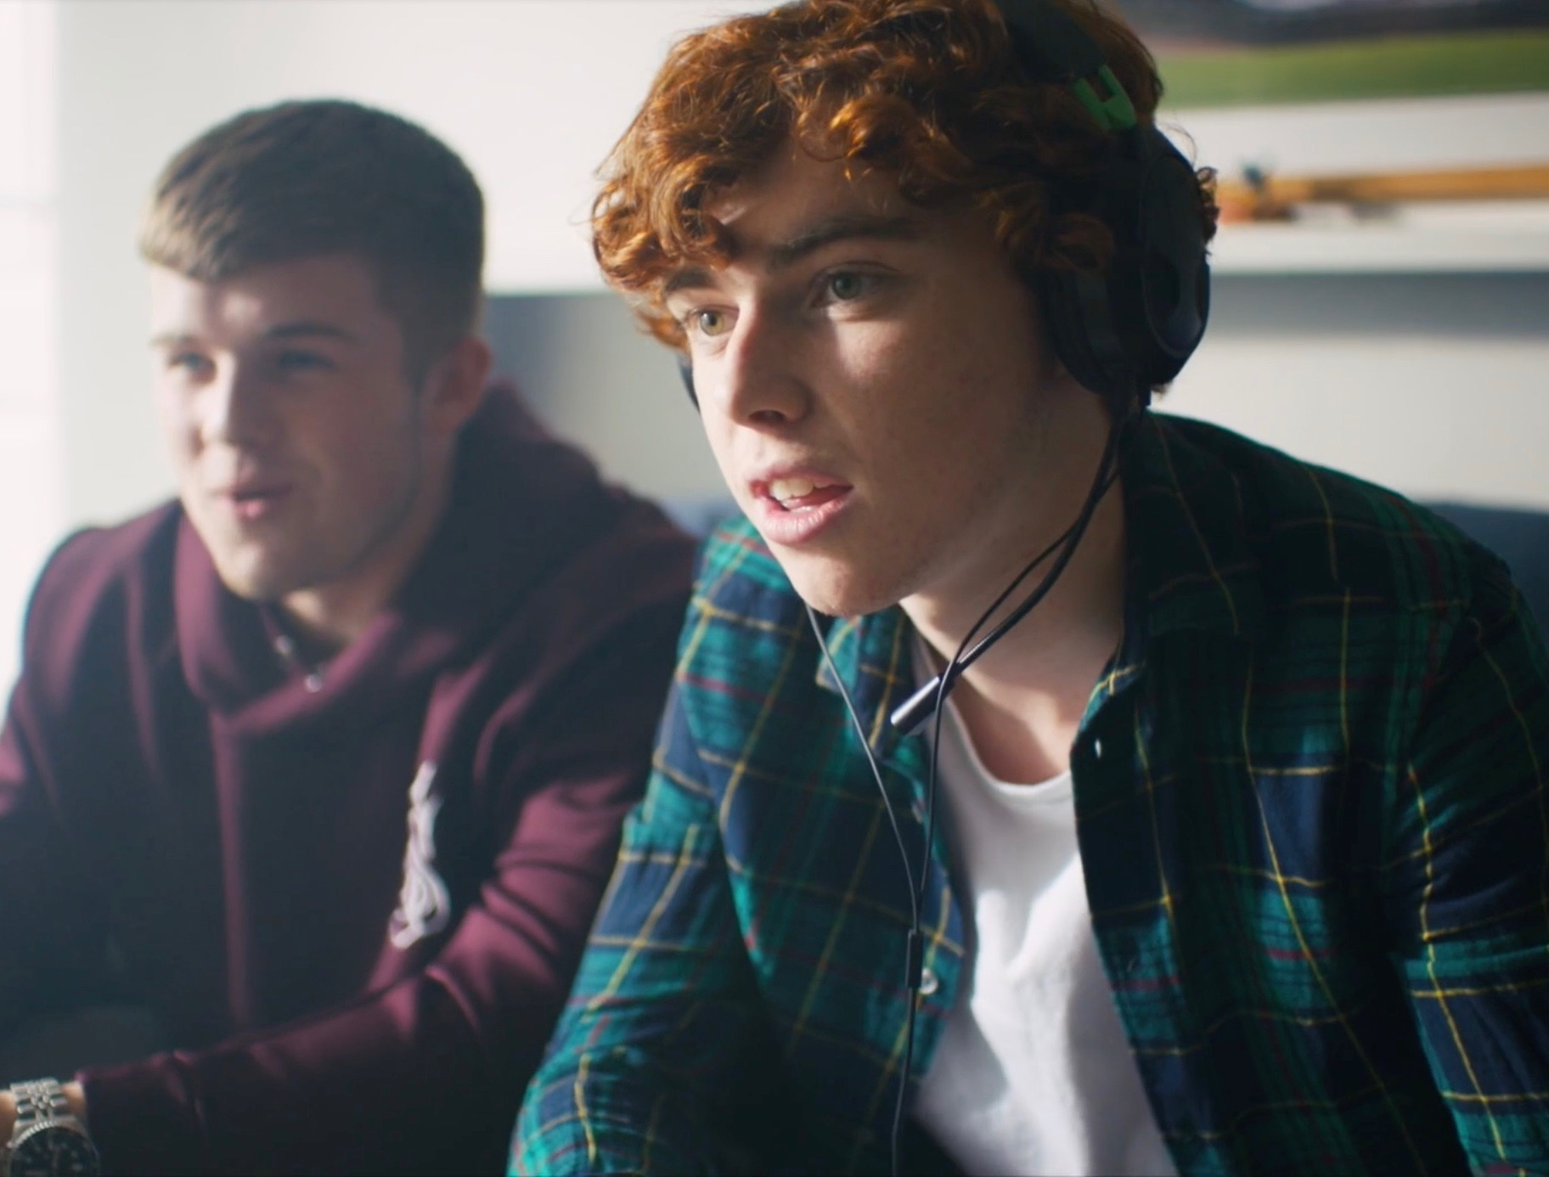
SCREEN TIME
How much is too much?
Agree limits
Walk the talk
Notes:
Are you concerned about how much time your child spends on their phone, tablet, or computer? We’ve put together a guide for parents to help deal with this tricky issue.
It is important to remember that children often welcome time-off from social media and games and can welcome clear guidelines and boundaries in this area.
How much is too much?
Unfortunately there is no magic number, children use their devices and computers for lots of different reasons – to learn, to play, and to socialise. The most important thing is to agree clear rules on screen time and set a good example, if you are concerned your child is spending too much time online.
Helpful Pointers
Agree a clear set of rules with your child on screen time in the home. Talk to your child on when and where you think it is appropriate to use screens. Agree times when screens are allowed and when they are not allowed in the home. We suggest dinner time, homework time and bed time is a good start to the not-allowed list.
Do as you say. Modelling behaviour is the most powerful way you can influence your child’s behaviour.
Restrict the use of computers and devices in the bedroom. Depending on the age of your child you may want to set a curfew or ban devices from the bedroom completely.
Buy an alarm clock for your child’s bedroom and charge their phones in your room or downstairs at night time. This can be a helpful way of giving them a break from the internet.
Try not to rely on screens too much to keep the kids amused. It can be easy to encourage them to pick up the tablet or play a game on the computer to keep them occupied. This only confuses rules on screen time, try and stick to the agreed rules with your child and remember to set a good example.
Chat to your child about what they do online and encourage them to use their screen time for learning and education.
Pick one evening a week where you do a family activity together, whether it’s movie night or games night. Doing activities together as a family will help implement screen time guidelines and offer fun alternatives.
Don’t have screens always on in the background. Turn off TVs and computers when not in use, these can be distracting for kids if they are trying to participate in another activity.
Finally, join in, why not set some time aside to play your child’s favourite computer game and discover the online world together.

Slide 7

VIDEO >>> IS MY CHILD SPENDING TOO MUCH TIME ONLINE?
Click the Link to play video >>> https://vimeo.com/353994676
Notes:
Áine Lynch, CEO of the National Parents Council Primary offers advice on managing screen time in the home.
Click the Link to play video or click the image on screen: https://vimeo.com/353994676
Please ensure pop-ups are enables on your computer. Video will play on vimeo. Alternatively videos can be accessed on the Webwise.ie/parents page.

Slide 8
6 Steps
Parents Can Take to Manage Online Safety

Slide 9
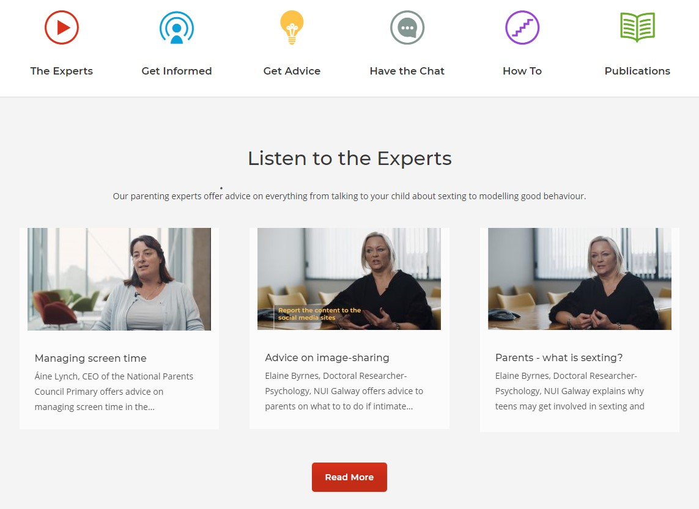
Webwise.ie/Parents
1. GET INFORMED
Notes:
The first step parents can take is by visit the Webwise Parent Hub. There’s lots of helpful information available on a range of online safety topics and issues.

Slide 10

WEBWISE.IE/PARENTS
Expert Advice Videos
Advice
Talking Points
How to
Notes:
Withing the parent hub you‘ll find…
Resources for Parents:
Parents' Guide to a Better Internet
This guide gives parents support, advice and information to help their children have a positive experience online. Topics explored in the guide include cyberbullying, screen time, sexting, social media and online pornography. This can be downloaded for free at Webwise.ie/parents
Advice Videos
The Webwise parenting experts offer advice on everything from talking to your child about sexting to modelling good behaviour. The expert videos feature advice from child psychologists, education experts, SPHE experts and tech experts.
Articles
‘Apps Explained’ - the latest apps and social networks children are using explained. This is updated on a regular basis and is an excellent starting point for parents who have children using social media for the first time.
‘Advice for Parents’ - advice and support for parents on key issues such as making friends online and sharing personal information.
‘Talking Points’ - to facilitate parents open communication with their child around internet safety.
‘How to’ -provide support and step by step instructions on blocking, reporting, parental controls and more.

Slide 11
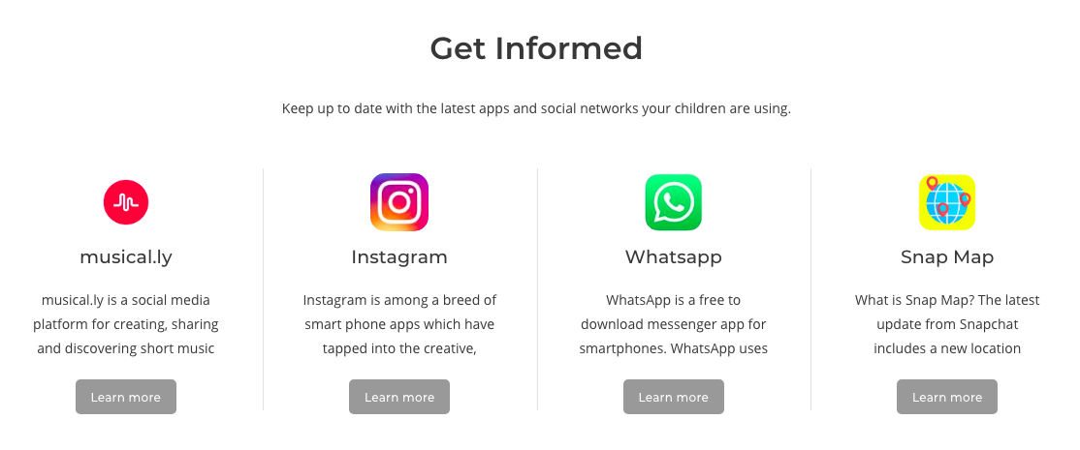
Webwise.ie/Parents – Apps Explained
Notes:
‘Apps Explained’ - the latest apps and social networks children are using explained. This section of the Webwise Parents hub is updated on a regular basis and is an excellent starting point for parents who have children using social media for the first time or if you are concerned about an app or platform your child may be using – you can find out more about it in this section.
AGE RESTRICTIONS ON SOCIAL MEDIA – WHAT I NEED TO KNOW
Most social media platforms and services have a minimum age requirement, for the majority of these services it is 13 years old and some are set at 16 (WhatsApp). Therefore technically, children under the age of 13 should not have a social media account. However most social media platforms do not have robust age-verifications in place making it relatively easy for underage users to sign-up with a false age.
Under the new E.U General Data Protection Regulation (GDPR), Ireland has now set the Digital Age of Consent to 16 years old. This is the age at which children can legally consent to companies/organisations processing their personal data or information for example when you sign up to an online platform or social media account. For children under the age of 16, consent must be given/authorised by the parent or guardian of the child. For the purposes of data collection teenagers between the age of 13 and 16 years old must have parental permission to sign-up to social media services.

Slide 12
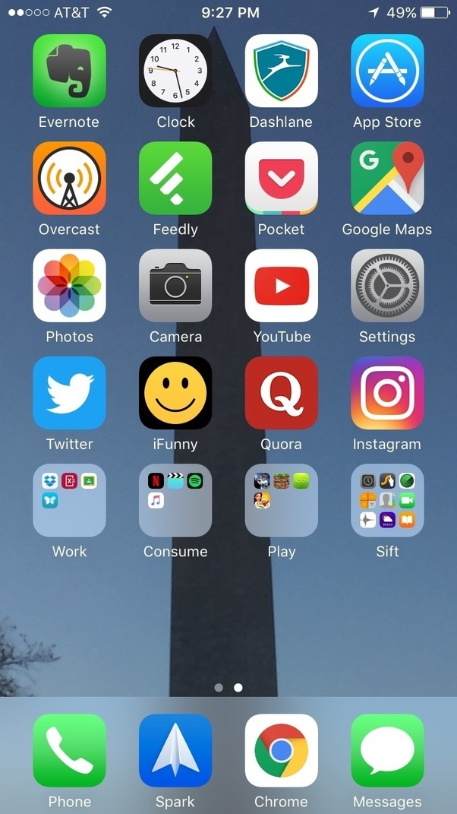
ACTIVITY: GET INFORMED
As a parent it is important that you understand what apps, games and social networks your child is using
Work in groups of four
Visit Webwise.ie/parents – Get Informed
Find the relevant explainer for the app/game/network given to your group
Have a quick review of the explainer and note down three points about the app (for example; potential risks, how it works, why it is popular).
Notes:
Activity Suggestion – Break the group into small groups and give them one app/network to look up on Webwise.ie
Ask each group to have a quick review of an explainer article – and ask them to note down three points about that app.

Slide 13

2. HAVE THE CHAT
Ask them about interests?
Webwise Talking Points
Keep talking!
Notes:
The most important thing parents can do when it comes to supporting their child online is have regular conversations. Have a conversation with your child on some of the important things to watch out for when going online for the first time.
Not sure how to start a conversation with your child – use the Webwise Talking points – available on the webwise.ie/parents hub.
We recommend that you speak to your child about what to do if they come across something on the internet that bothers them. This could involve closing the laptop lid, or turning off the screen, and coming to get you.
Finally - Keep checking in with your child! Online safety isn’t a once off conversation. The internet is part of all our world now, so it is vital that parents/guardians continue the conversation.

Slide 14
2. HAVE THE CHAT – ONLINE GAMING
Here are some helpful talking points to help start the conversation with your child about online gaming:
1. Can you show me your favourite game?
2. Can you play against other kids?
3. How much time should you spend playing?
4. Can you chat with the other kids you are playing?
5. What sort of information is NOT okay to share when gaming?
6. What would you do if something inappropriate happens when you are playing a game online?
Notes:
Lets look at online gaming as an example. Here are some helpful talking points to help start the conversation with your child about online gaming:
1. Can you show me your favourite game?
It is a good idea to get to know the games yourself, why not sit down with your child and let them show you how the game is played. Talk to your child about what they can do in the game they are playing. What is the overall objective of the game, what do they like most about playing it, and is there anything about the game that they don’t like.
2. Can you play against other kids?
Some games have optional multi-player modes where your child can play with and against others. Make sure you are clear on whether you are happy for your child to play with others. If you are, ask them who they are playing with? Establish rules around this that you can both agree on. Most games have a rating you can check to see if they are age appropriate.
3. How much time should you spend playing?
It makes life a lot easier if you bring this subject up early on; it can be tricky to change well-established practices. Talk about why it is important to have limits. it is a good opportunity to talk about the importance of being active, being outdoors, and spending time in the company of other children. Striking a suitable balance is key.
Remember, it can be hard to enforce restrictions. It can also be difficult to accurately track the amount of time they are spending playing the game. Some devices allow you to use parental controls to strictly enforce daily or weekly limits. In many cases, the device simply switches off once the allocated time has been exceeded. While this is handy; it can be very frustrating for a child who is just about to reach a landmark in the game after a great deal of effort. We recommend not relying exclusively on parental controls. Use them to support your usual parenting approaches.
4. Can you chat with the other kids you are playing?
Many games allow players to chat with each other. Agree rules around this, ask your child about who they think it is okay to talk to online. Discuss your expectations around the type of language they should not use and how they treat others. Be very clear on consequences of using bad language, being disrespectful, or not following the other agreed rules. The threat of withdrawing access to the game can be a good deterrent to bad behaviour.
Check if the game gives the option of disabling chat and if there is a safe chat mode. Some games allow limited forms of chatting where gamers can communicate with each other by selecting from a menu of phrases.
5. What sort of information is NOT okay to share when gaming?
Explain to them the importance of not giving away any personal information online. In the case of online gaming it is a good idea not use real names for game profiles and not to share passwords with friends.
6. What would you do if something inappropriate happens when you are playing a game online?
It is important that your child is familiar with safety setting, privacy and reporting tools. It is equally important that your child understands they can talk to you if they experience anything inappropriate online. This is also a good opportunity to encourage your child to play fairly and treat other gamers with respect.
For more information on gaming go to: webwise.ie/parents/play-it-safe

Slide 15

VIDEO >>> TALKING TO YOUR CHILD ABOUT WHAT THEY DO ONLINE
Click the Link to play video: https://vimeo.com/353996493
Notes:
CEO of National Parents Council; Áine Lynch on the importance of talking to your child about what they do online.
Click the Link to play video: https://vimeo.com/353996493
Please ensure pop-ups are enables on your computer. Video will play on vimeo. Alternatively videos can be accessed on the Webwise.ie/parents page.

Slide 16
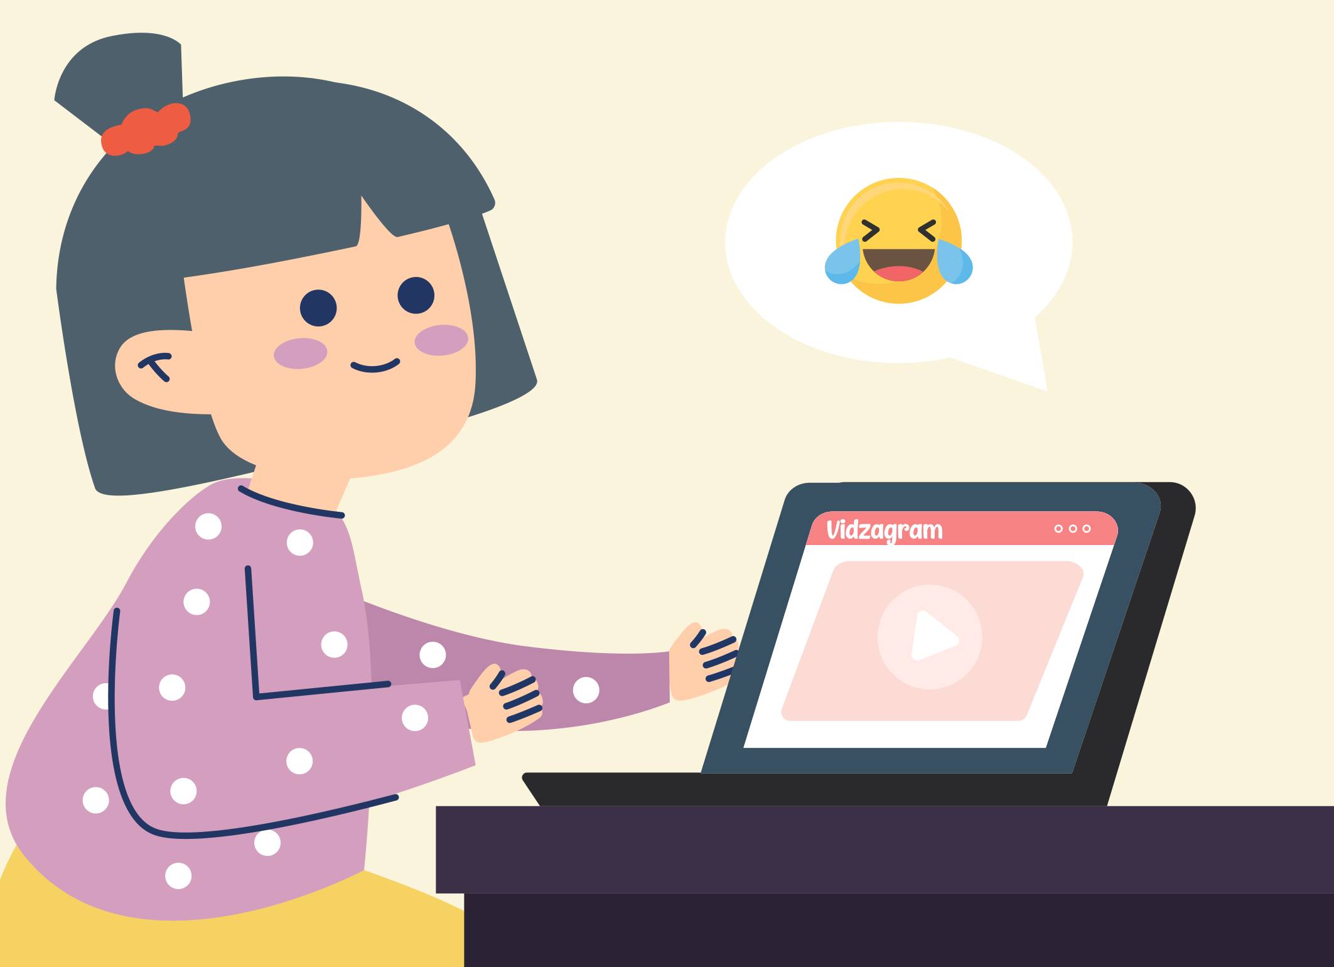
3. AGREE RULES
Have a two way conversation
Set clear boundaries
Follow the rules!
Notes:
Agree with your child rules for Internet use in your home
Try to reach an agreement with your child on the guidelines which apply to Internet use in your household. Here are some tips to get started:
Discuss when and for how long it is acceptable for your child to use the Internet
Agree how to treat personal information (name, address, telephone, e-mail)
Discuss how to behave towards others when gaming, chatting, e-mailing or messaging
Agree what type of sites and activities are OK or not OK in our family
Follow the rules yourself! Or at least explain why the rules are different for adults.

Slide 17
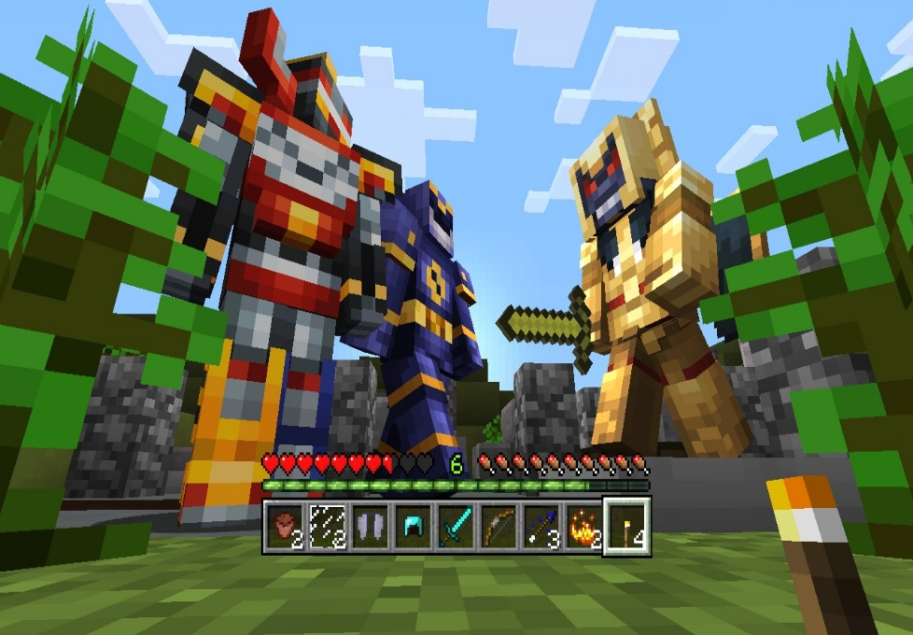
ONLINE GAMES: THINGS TO CONSIDER
CHECK AGE RATING
USE PARENTAL CONTROLS
AGREE LIMITS
KNOW WHO THEY ARE PLAYING WITH
Notes:
Lets go back to online gaming, what can parents do and what rules can you put in place to ensure your child makes the most of their time online.
What is Online Gaming?
Online gaming is becoming increasingly popular among children and teenagers, with 36% of children in Ireland playing online with other people in 2014, compared with 30% in 2011 (Source: Net Children Go Mobile – January 2015).
Games can range from task/mission based activities to sports themed games and anything in between. Online games can be an excellent way to link up with people, develop teamwork skills and of course are a source of entertainment and recreation for young people.
Many of you will be familiar with the more traditional gaming formats where you buy physical games for popular consoles, such as Xbox, PlayStation or Nintendo. Online games are played on the internet via a computer console, mobile device or application. What makes it different from more traditional gaming is the ability to play and communicate with other gamers online.
What Types of Online Games are there?
There are many different forms of online games. These range from free games or apps that can be downloaded on mobile phones to games that can be played on internet-enabled consoles, for example PlayStation or Xbox.
Web Games and Apps: Games that can be played on the internet through specific websites, or through apps that can be downloaded to mobile phones. This type of games includes games played via social media services, for example via Facebook, which allow players to connect with friends.
Console Games: Games that are played via entertainment consoles, for example Xbox, PlayStation or Nintendo. Consoles are connected to TVs and games can be purchased in stores or downloaded online.
Mobile Games: Games that can be downloaded to your mobile phone. Many are free to play initially, however charges are often introduced within these games. For example users can sometimes pay to gain additional functionality to help them complete a game. These in-game purchases can normally be deactivated in the users’ mobile settings.
Handheld Games – Devices like iPads or Nintendo DSI’s also host online gaming.
Multi-Player Gaming
Many online games allow for multiplayer modes which can pose some risks to young people. In multiplayer mode users can play other gamers from anywhere in the world. Some of these games allow users to send messages to each other via text or audio modes. In some cases young players can experience abuse/harassment online from other gamers, particularly when emotions are high after a competitive game.
Players can be exposed to inappropriate language from gamers and in some cases young people may leave themselves open to unwanted contact by sharing personal information via their profiles or by talking with other players.
To avoid this, ensure your child’s profile is private and encourage your child not to use real photos or full names for their gaming profile and not to share any personal information. It’s also a good idea to let your child know to speak to you if they feel uncomfortable or are not sure about something they have encountered while gaming. Make sure your child knows how to block a player who sends upsetting messages.
Pay to Play
Many online games are free to download. However these games can offer additional functions, once the game is live, which users can purchase. It is a popular practice among downloadable games and apps to offer players the chance to buy access to the next level of a game or to purchase functions to help them complete games. It can be very easy for players to inadvertently run up bills on these games. To avoid this, parents should ensure that they have a password set on their phone/device for in-app purchases or that they switch off this option on the phone/device; this can normally be done within the app/mobile settings.
Tips for Keeping Your Child Safe –
Here are a few helpful tips to ensure a safe online gaming experience for your child.
Check the age rating of the games your children are playing and ensure games are age appropriate.
Advise your child not to share personal details online or in their profiles. In the case of teens, it may be best to discuss the dangers of sharing information online.
Encourage your child to play fairly and treat other gamers with respect.
Use family safety settings to protect your child from discovering games which may not be age/content appropriate.
For many parents it is useful to agree time limits on gaming with their children.
Playing games online can leave computers/devices open to risk of a virus. Protect your computer by ensuring you have up to date anti-virus software in place.
Ensure your child knows how to report or block other players who engage in online harassment or any other unsuitable behaviour.

Slide 18

VIDEO >>> AGREEING RULES AROUND TECHNOLOGY USE IN THE HOME
Click the Link to play video: https://vimeo.com/200804832
Notes:
Child Psychologist Dr. John Sharry offers advice on agreeing rules around technology use on the home.
Click the Link to play video: https://vimeo.com/200804832
Please ensure pop-ups are enables on your computer. Video will play on vimeo. Alternatively videos can be accessed on the Webwise.ie/parents page.

Slide 19
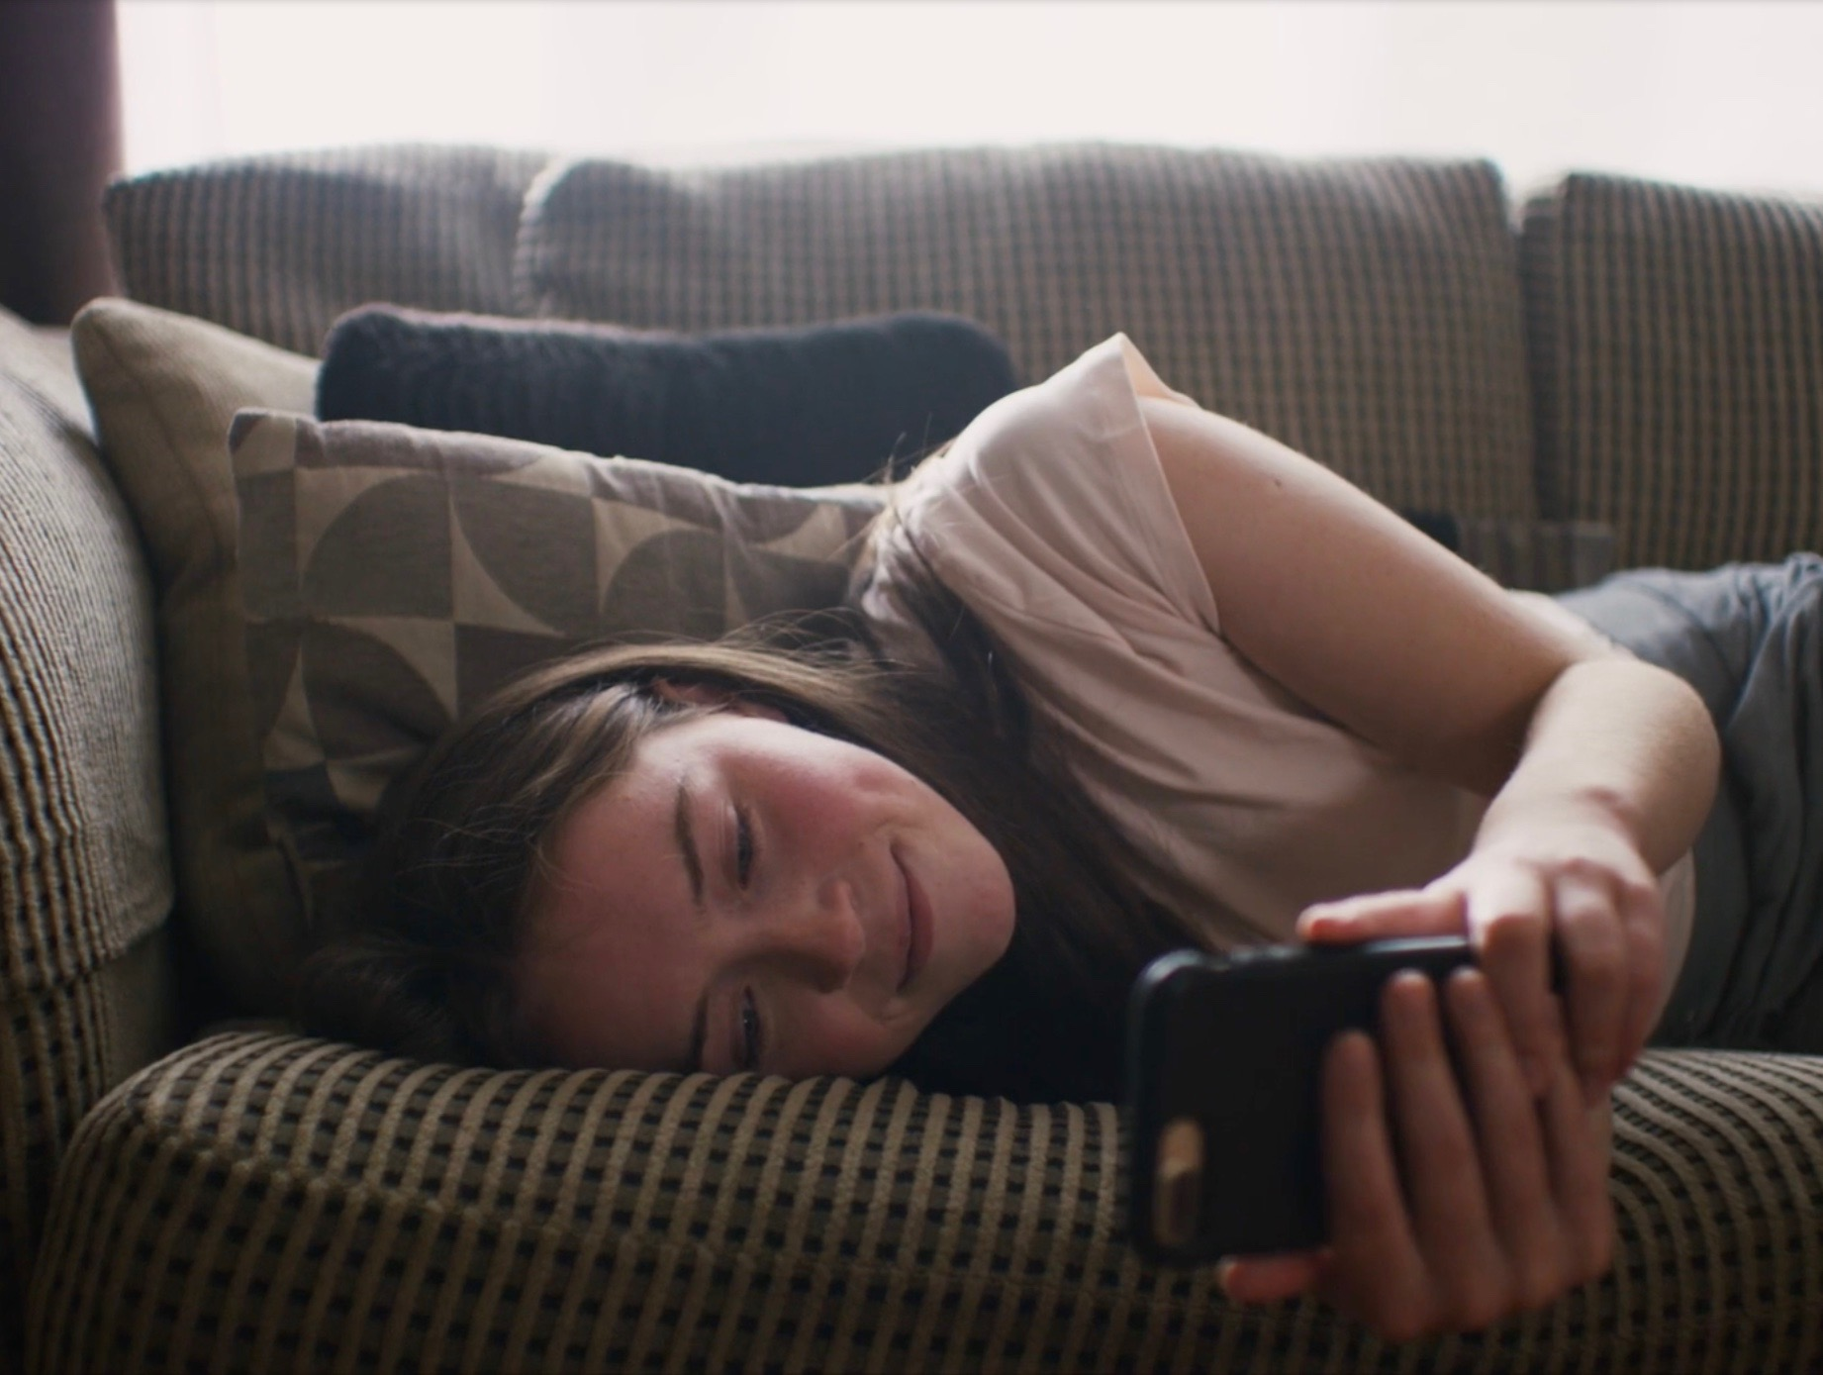
4. ASK FOR HELP
Reassure your child
Don’t panic
Avoid total bans
Notes:
Reassure your child that they will be listened to and they should come to you if something comes up online.
Listen to what your child has to say to help them make sense of what’s happened.
Stay calm and don’t panic. The best way to do this is make sure you have an open dialogue from the beginning.
Don’t be too critical towards your child’s exploration of the Internet
Children may come across adult material by accident on the web. Also, a child may intentionally search for such websites; remember that it is natural for children to be curious about off-limits material. Try to use this as an opening to discuss the content with them, and perhaps make rules for this kind of activity. Be realistic in your assessment of how your child uses the internet.
We live in an increasingly digital world, It is important that children learn how to use digital technology in a safe manner.
Let your children know that they can come to you if something happens online or something is bothering them. Sometimes teens may not tell you about a bad experience if they know it will lead to getting cut off from their online world. If they feel like they can talk about their online habits with you, without judgement or the treat of being disconnected, it will lead to more honesty in the long-run.
Having continuous open communication is a vital part of helping your child engage positively online

Slide 20

VIDEO >>> WHAT TO DO IF SOMETHING GOES WRONH ONLINE
Click the Link to play video: https://vimeo.com/354004510
Notes:
So what can we do if something does go wrong online?
Áine Lynch, CEO of the National Parents Council Primary offers advice for parents on supporting their children online.
Click the Link to play video: https://vimeo.com/354004510
Please ensure pop-ups are enables on your computer. Video will play on vimeo. Alternatively videos can be accessed on the Webwise.ie/parents page.
TOP TIP: Talk to other parents, peer support can be a really effective way to address issues, agree strategies together as parents.

Slide 21

5. LEAD BY EXAMPLE
Model good behavior
Follow the rules
Promote respect and consent
Notes:
Often guilty of mindless scrolling yourself? Modelling good behaviour is one of the most powerful ways you can influence your child’s behaviour. If you set rules around internet use at home (for example, no technology at the table), it’s important that you follow the rules yourself and lead by example.

Slide 22

VIDEO >>> LEAD BY EXAMPLE
Click the Link to play video: https://vimeo.com/191043980
Notes:
CEO of National Parents Council; Áine Lynch on the the importance of modelling good behaviour when it comes to addressing internet safety in the home.
Click the Link to play video: https://vimeo.com/191043980
Please ensure pop-ups are enables on your computer. Video will play on vimeo. Alternatively videos can be accessed on the Webwise.ie/parents page.

Slide 23
6. FINALLY JOIN IN!
The internet is a great tool!
Discover the internet together
Get involved in
Safer Internet Day
Notes:
Remember that the positive aspects of the Internet outweigh the negatives.
The Internet is an excellent educational and recreational resource for children. Encourage your child to make the most of it and explore the internet to its full potential.
Discover the Internet together
Be the one to introduce your child to the internet. For both parent and child, it is an advantage to discover the internet together. Try to find websites that are exciting and fun so that together you achieve a positive attitude to internet exploration. This could make it easier to share both positive and negative experiences in the future.
Let your children show you what they like to do online
To be able to guide your child with regard to Internet use, it is important to understand how children use the Internet and know what they like to do online. Let your child show you which websites they like visiting and what they do there.
About Safer Internet Day
Safer Internet Day (SID) is an EU wide initiative to promote a safer internet for all users, especially young people.
Safer Internet Day offers a great opportunity for parents to have a chat with your child about online safety. Celebrated every February, Parents can get involved by using the brilliant resources and videos developed by Webwise.

Slide 24
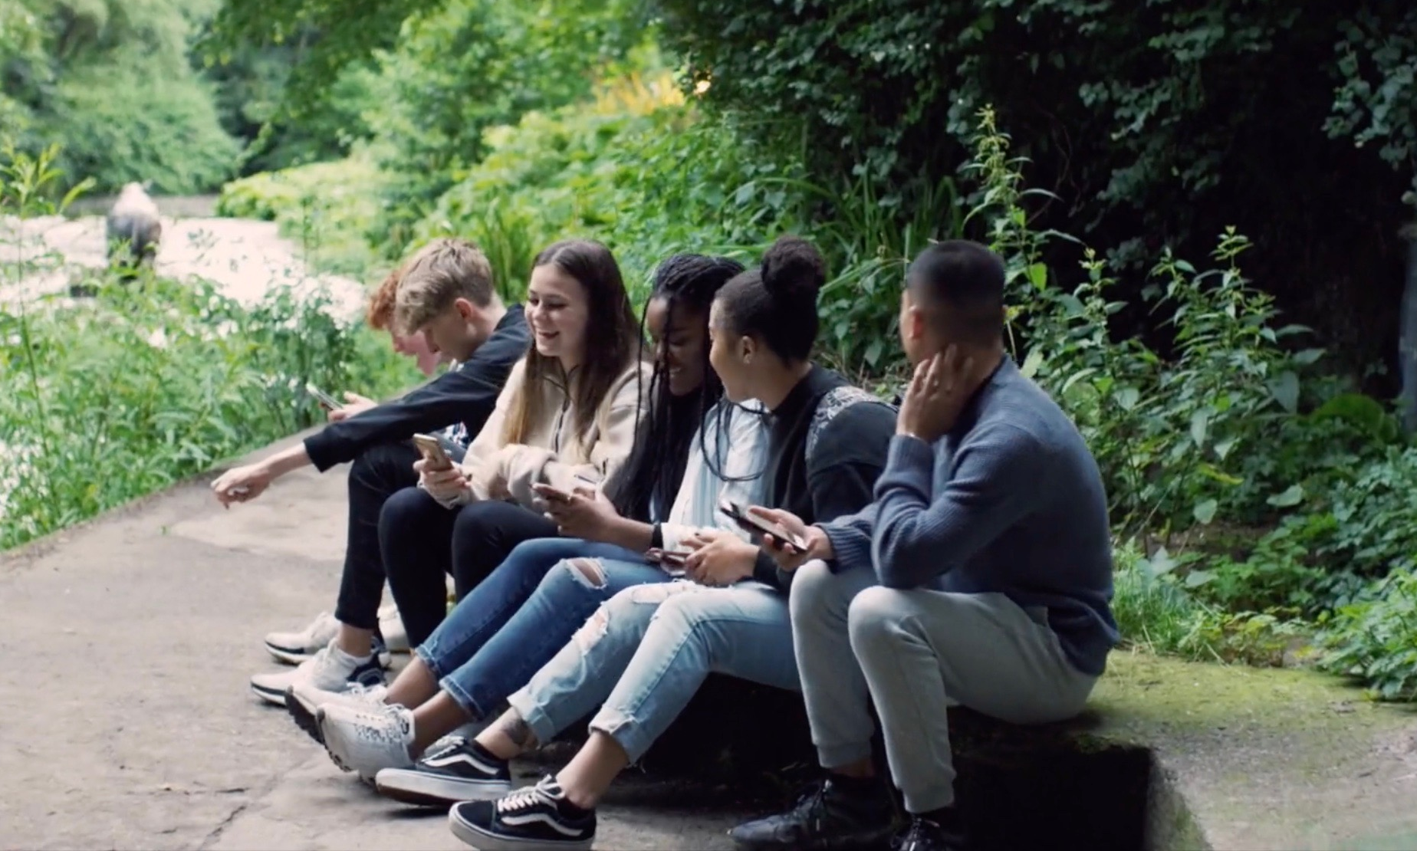
ACTIVITY: RESPECTFUL COMMUNICATION
Go to p.18 of the Webwise Parents booklet offering advice on what advice to give their child on cyberbullying.
Spend a few minutes in pairs going over the advice and agree some steps they would take on what a parent can do their child is being bullied online.
Click the Link to play video: https://vimeo.com/359094916
Notes:
This final activity looks at cyberbullying and respectful communication.
Play the Connected Video: https://vimeo.com/359094916
Ask parents to go to p.18 of the Webwise Parents booklet offering advice on what advice to give their child on cyberbullying. Ask them to spend a few minutes in pairs going over the advice and agree some steps they would take on what a parent can do their child is being bullied online.
Sample answers include: Listen to your child, be supportive, seek advice from school – they may be able to help, keep the evidence. In serious incidents report it to the Gardai,

Slide 25
ACTIVITY: REFLECTION
Think back over some of the issues we have spoken about today:
Parental Controls
Managing Screen time
Setting guidelines around technology use
Online Gaming
Talking to your child about online safety
Leading by example
Respectful Communication
Create a to do list of actions that you think will help
your children to have more positive online experiences.
Notes:
Reflection slide
Think back over some of the issues we have spoken about today:
Parental Controls
Managing Screen time
Setting guidelines around technology use
Online Gaming
Talking to your child about online safety
Leading by example
Respectful Communication
ACTIVITY
Create a to do list of actions that you think will help your children to have more positive online experiences.
Suggestion – go around the room and take some responses from the group

Slide 26

SUPPORT FOR PARENTS: NPC.IE
Notes:
National Parents Council Primary
The parent association is the structure through which parents in a school can work together for the best possible education for their children. The parent association works with the principal, staff and the board of management to build effective partnership between the home and school. Partnership between the home and school is important because with positive and active partnership the child gets the best that primary education can offer.
Free Supports for Parents
NPC Primary – Helpline
NPC Information/Helpline is a confidential service for parents. The Information/Helpline officers listen, and give information and support to parents to help them make the best possible decisions for and with their children
If you have a query on any aspect of your child’s education please contact the Helpline on Tel: 01-8874477 email: helpline@npc.ie
The Helpline is open from:
Monday & Tuesday from 10am to 4pm
Wednesday to Friday from 10am to 5pm
Free Resources
Free Online Training for Parents on Internet Safety
The overall objective of this online session is to provide parents with information and skills to support their children's online activity.
Internet Safety Workshops
The NPC Primary offer Internet Safety workshops for parents which can be hosted in the local school. To book a workshop or access the online course visit NPC.ie

Slide 27

NEXT STEPS
Visit Webwise.ie/Parents
Have the chat
Agree guidelines
Keep up to date..
Follow Webwise Ireland

Slide 28

THANKS!
ANY QUESTIONS?
www.webwise.ie
www.npc.ie
© Webwise_Ireland
This work is made available under the terms of the Creative Commons Attribution Share Alike 3.0 Licence http://creativecommons.org/licenses/by-sa/3.0/ie/. You may use and re-use this material (not including images and logos) free of charge in any format or medium, under the terms of the Creative Commons Attribution Share Alike Licence.

